Slide 1
Safe use and storage of tools, materials and equipment
Induction presentation

Slide 2
Setting out tools uses
Steel rule – a steel rule is used for marking and measuring it is very handy in joinery and carpentry as it has measurements in millimetres on the edge and inches on the other edge. Steel rulers are also more durable so would last longer than a plastic or wooden one. Steel rulers are heavier than a plastic ruler, so it is easier to mark with it without it moving.
Carpenters pencil – a carpenter's pencil is used to mark out things that need to be cut. You can use them on wet or dry wood, concrete and stone. A carpenter's pencil is different to a regular pencil as they are shaped different. Carpenter’s pencils are rectangular, and a regular pencil is the shape of a hexagon this is so that carpenter pencils do not roll away. Carpenter’s pencils are also thicker so that you can see the lines more as there is more lead in them.

Slide 3
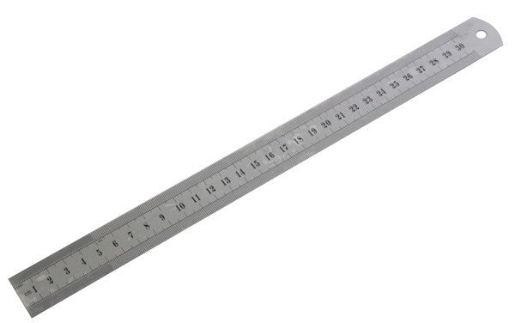
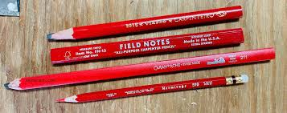
Setting out tools uses
Steel rule
Carpenter pencil

Slide 4
Setting out tools uses
Combination square- a combination square is used to mark out lines on wood just like a steel rule the difference is that you can also use it to measure inside and outside angles. This is a really good tool if you need to measure a 90 degrees or 45 degrees angle quickly.
Tape measure – a tape measure is used to measure distance or size, they are flexible, so you can measure a long distance whereas a ruler you are only restricted to 30cm or a 1metre. Tape measures also have a clip on them so you can carry them with you on a work belt and they will not get lost. The tape measure will measure in centimetres, millimetres, metres, feet and inches. You can also get a specific tape measure that will have the measurements of bricks written on them.

Slide 5
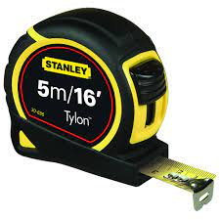
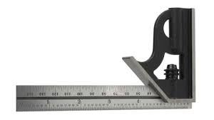
Setting out tools uses
Combination square
Tape measure

Slide 6
Setting out tools uses
Spirit level – a spirit level is used to see how level something is. This could be used for checking how level the joints are in a bridle joint, mitre joint, half lap joint, housing joint, tee halving joint, dovetail joint, mortice and tenon joint).
Marking gauge- a marking gauge is used to mark out lines on a straight edge, they are mainly used by joiners as they will need to cut accurately to ensure that pieces will fit together correctly.

Slide 7
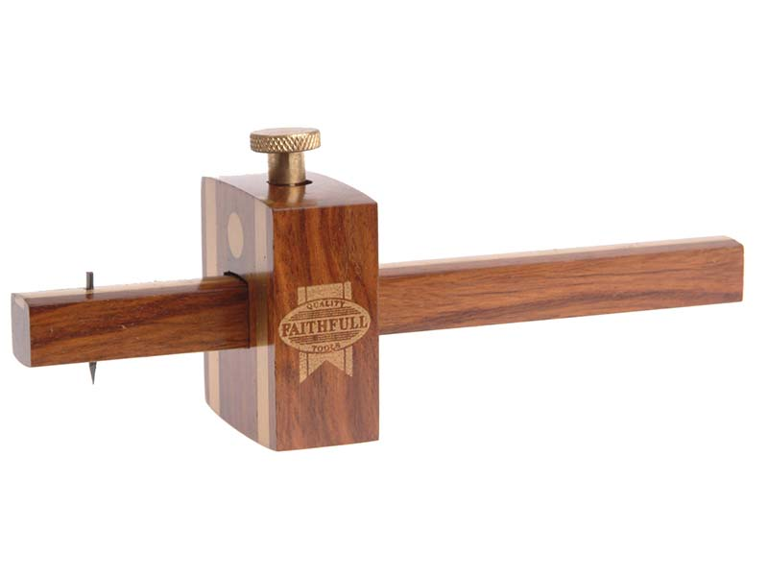
Setting out tools uses
Spirit level
Marking gauge

Slide 8
Hand tools
Mallet – a mallet is used alongside a chisel to knock wooden pieces together. They are good because they will not damage the wood that has been hit. A mallet can also be used to connect joints together. Mallets can also be different sizes and be made from wood, metal or plastic.
Chisel – a chisel is used to carve wood, stone and metal. A chisel can also be used to cut and shape wood. Chisels are tools that have a bladed edge and when hit with a mallet, will help shape the material.

Slide 9
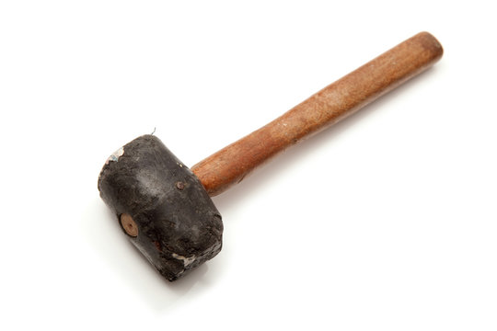
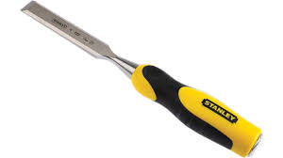
Hand tool uses
Mallet
Chisel

Slide 10
Hand tools
Tenon saw- a tenon saw is used to cut hard or soft wood, they are named after the tenon and mortice joints. It has a short blade which helps to make a straight cut. A tenon saw is better to use when cutting wood as it gives you more control of the depth and direction you are trying to cut. They will usually have between 10 and 14 teeth per inch.
Claw hammer- a claw hammer is used to pull nails out of wood or driving them into the wood. A claw hammer is better than a regular hammer as it has more leverage and a better grip to pull out nails.

Slide 11
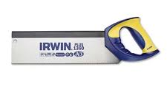
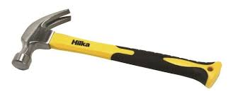
Hand tool uses
Tenon saw
Claw hammer

Slide 12
Hand tools
Universal saw – a universal saw is used for cutting wood, this would be used on bigger pieces of wood. Universal saws are generally better for cutting larger pieces of wood due to them having larger blades.
Nail punch- a nail punch is used to hide nail heads. They are used to make joint look better so that nails are not showing through wood joints. They can also be used to remove nails that are exposed. It works by placing the nail punch over the exposed nail and then hitting it with a hammer until it is not exposed anymore.

Slide 13
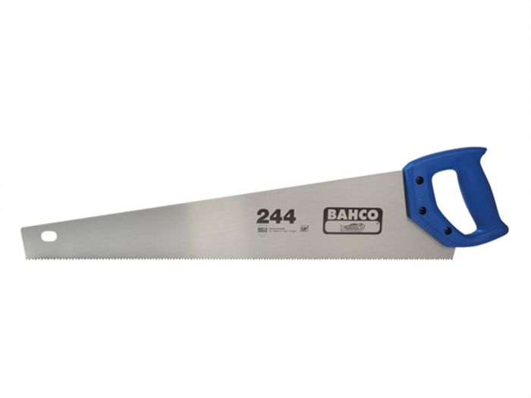
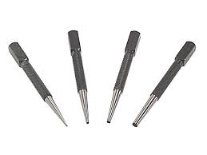
Hand tool uses
Universal saw
Nail punch

Slide 14
Fixings
Here are the different types of fixing that can be used in joinery and carpentry:
Oval nails
Round wire nails
Pozi drive woodscrews
Wall plugs
Panel pins.

Slide 15
Fixings
Oval nails- these are used in carpentry and joinery to give a clean finish and to hide them. These type of nails do not break, or split wood easily so are used more often.
Round wire nails- these are used in carpentry and joinery when you want to strengthen wood and where a clean finish is not essential. These type of nails are long lasting and keep their strength.
Pozi drive woodscrews- these are used for furniture, cabinets and other things that are found in the house. They come in a range of sizes such as 3mm, 3.5mm, 4mm, 5mm and 6mm.
Wall plugs – these are used for to support things that need hanging on a wall such as a cabinet, mirror or shelves. They are mainly used to support objects on a weaker material wall such as plasterboard.
Panel pins- these are used in joinery to keep things in place such as a skirting board. Panel pins are small, but they keep things in place and secure.

Slide 16
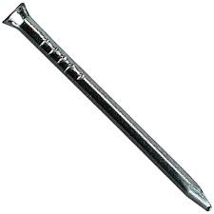
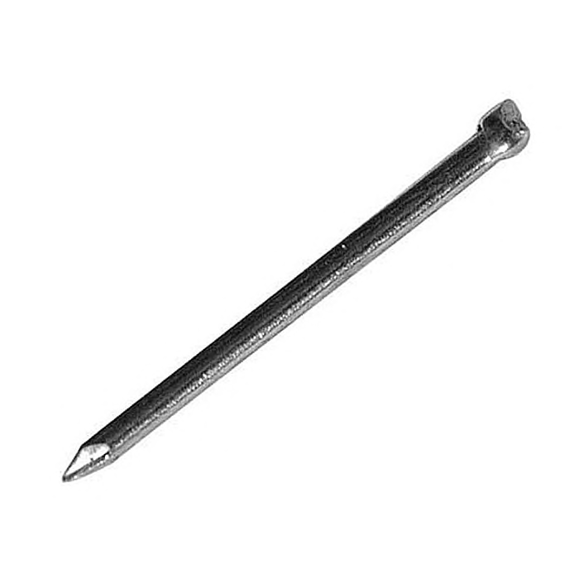
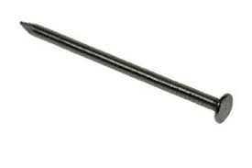
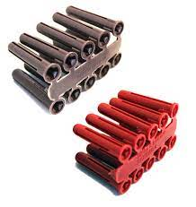
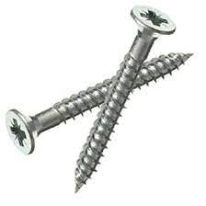
Fixings
Panel pins
Oval nails
Round wire nails
Pozi drive woodscrews
Wall Plugs

Slide 17
Glue
PVA (Polyvinyl Acetate) is used for holding wood joints together, it is very fast drying, but you do have to be careful when using it. If you do not wipe off the excess glue it will dry onto the wood and will be harder to get off.
Hot glue- hot glue is used in a glue gun and it joins wood together. It is thicker than usual glues but can be used if you do not have nails or do not want to use them . The problem with hot glue is that it dries fast so you would need to be fast when using it.

Slide 18
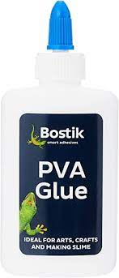
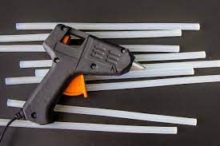
Glue
Hot glue
PVA glue

Slide 19
Wood
Redwood – this type of timber and is used on skirting boards, staircases and outdoor furniture. It can be sawn and drilled easily with normal tools such as universal saw or a tenon saw.
Plywood - Plywood is thin sheets of wood glue together. It is cheaper to buy, and it is used on floor, walls and roofs. This type of wood is strong, durable and it doesn’t warp or crack.
Oak – oak is used quite a lot in joinery and carpentry as it is strong, dense and durable. It is also known for its look, and it also stain and polishes better than other wood.

Slide 20
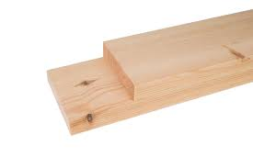
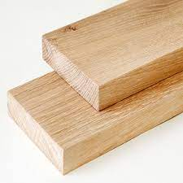
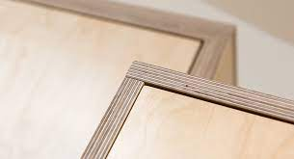
Wood
Redwood
Plywood
Oak

Slide 21
Equipment
Sash cramps- these are used to hold large panels and other objects in place. Cramps are also used to hold joints and apply pressure at the same time.
Bench hook – these are used to keep wood in the correct place whilst it is being cut. They are used to make sure the wood does not move around so that you get a straighter cut and you do not injure yourself.
Woodworking bench with vice- this is used mostly when drilling and chiselling to ensure that the joint or piece of wood stays in place without injuring the person. It can be used for both light or heavy-duty work as it can hold big or small pieces of wood.

Slide 22
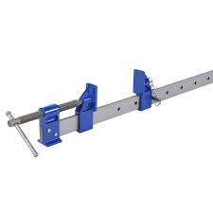
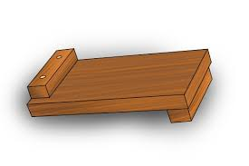
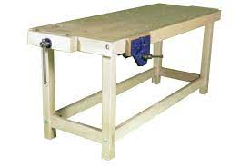
Equipment
Sash cramps
Bench hook
Woodworking bench with vice

Slide 23
Safe use and storage
It is important when using tools, equipment and materials that you follow the correct health and safety procedures these include:
Wearing a high-visibility jacket this is used to make people aware that you are there,
Safety boots- these should be worn to ensure that if anything heavy drops on your feet that they are protected as they made from heavy duty reinforced steel.
Eye protection and dust mask- these should be worn to ensure eyes are protected from flying pieces of wood that are being cut or chiselled. Dust masks are to be warn to make sure that dust does not enter the lungs as it can cause severe illnesses.

Slide 24
Safe use and storage
Tools should be used following the correct behaviour and following the health and safety guidelines.
Materials should be lifted, moved or stacked using the correct moving and handling techniques. If you do not use these techniques, it could cause back or knee injuries.
Workstations should be cleaned at all times to make sure that nobody is injured from slipping, tripping or falling over things.
Tools should be cleaned after use so that they are ok for other people to use in the future.

Slide 25
Safe use and storage
Tools should be used following the correct behaviour and following the health and safety guidelines.
Materials should be lifted, moved or stacked using the correct moving and handling techniques. If you do not use these techniques, it could cause back or knee injuries.
Workstations should be cleaned at all times to make sure that nobody is injured from slipping, tripping or falling over things.
Tools should be cleaned after use so that they are ok for other people to use in the future.

