Slide 1
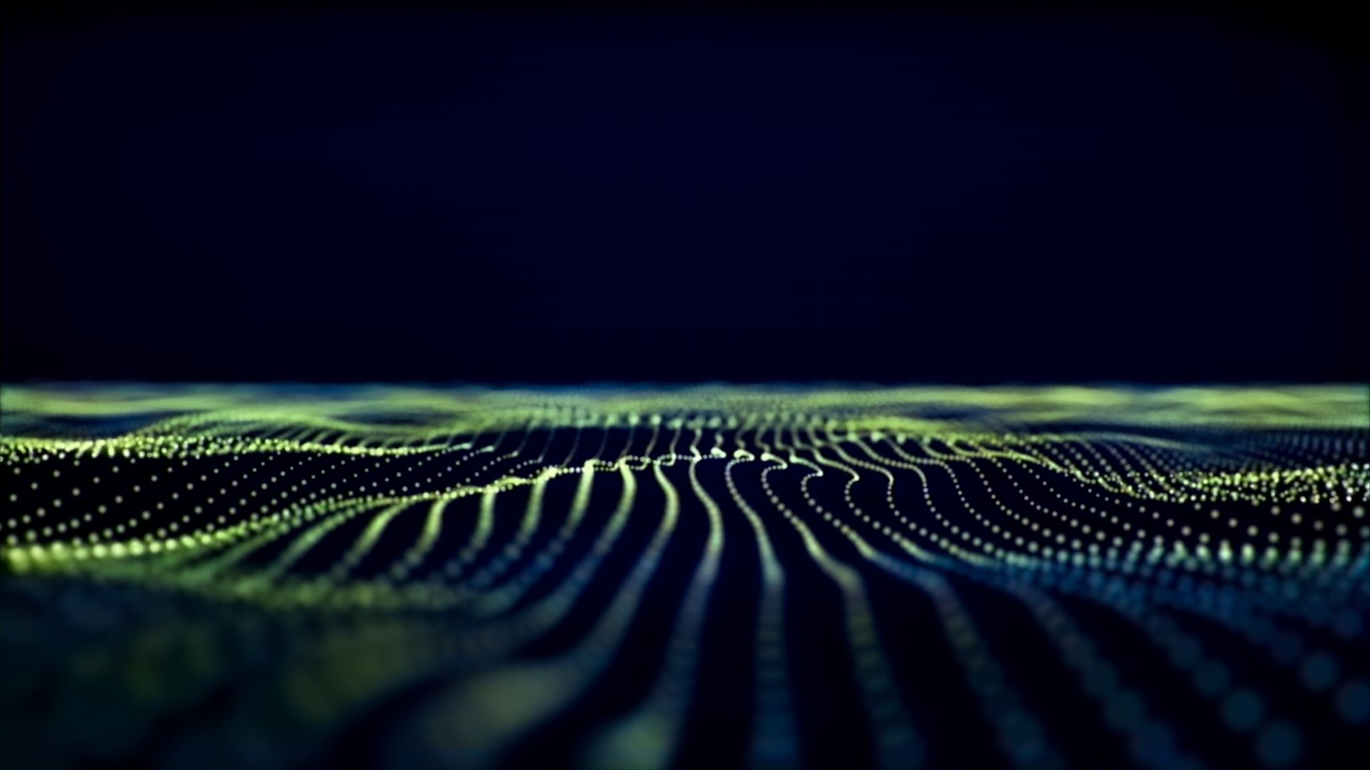
Unit 11- Animation
Introduction to unit

Slide 2
Unit introduction
Have you ever wondered how all the animations you come across are made? The creative media industries use animated content in a wide variety of digital products and require people to work on their design and production.
Animation is used in many sectors of the creative media industries including advertising, video games, music videos, films, television, mobile phones and websites. With such a wide variety of uses it has great potential for the expression of creativity and innovation. Large and small companies, as well as freelance producers, create animation across the UK. The industry requires people to work in highly skilled and specialised roles to create animations in a range of formats for a variety of purposes and audiences.

Slide 3
Learning aims
In this unit you will:
A explore developments in animation
B understand the uses and techniques of animation
C produce animated content for digital media
D review your own animated production.

Slide 4
Learning hours and assessment
This unit is 60 hours, and this includes time to do your assessments.
You will have an assignment to do for learning aim A, B, C & D

Slide 5
Assessment criteria

Slide 6
Assessment criteria

Slide 7
Topic A.1 The development of animation technology
Phenakistoscope (Joseph Plateau, 1832)
Every day we see so many examples of moving images on our phones, laptops, and TVs that it’s hard to conceive of a time before they existed.
GIFs, animations, films, TV shows—they’re everywhere, all the time, but everything has an origin, and the story of animation and moving image stretches back almost two full centuries to the invention of the Phenakistoscope.
The Phenakistoscope is actually the earliest animation device to demonstrate continuous movement. It uses the persistence of vision principle to give the illusion of motion and works in a similar way to film. In both instances, they use minimal differences between images to create the illusion of movement.

Slide 8
Topic A.1 The development of animation technology
Phenakistoscope (Joseph Plateau, 1832) how it works.
The phenakistoscope was invented by Joseph Plateau and it was also known as the spindle viewer. It consisted of two disks, one with small equidistant radial windows, through which the viewer could look, and another containing a sequence of images drawn around the disk in concentric circles.
When the viewed in a mirror through the first disk’s slots, the pictures on the second disk appeared to move. The synchronisation of the windows and the images created an animated effect.

Slide 9
Topic A.1 The development of animation technology
Phenakistoscope (Joseph Plateau, 1832) how it works.
https://www.youtube.com/watch?v=BefB2qFB6Sc

Slide 10
Topic A.1 The development of animation technology
Phenakistoscope (Joseph Plateau, 1832) how it works.
I would like you to design your own phenakistoscope that we will then make.

Slide 11
Topic A.1 The development of animation technology
Zoetrope (William Horner, 1834) A Zoetrope is one of several pre-film animation devices that produced the illusion of motion. It did this by displaying a sequence of drawings or photographs showing progressive phases of that motion. The zoetrope (above) consists of a cylinder with slits cut vertically in the sides. On the inside of the cylinder is a band with images from a set of sequenced pictures. As the cylinder spins, you are able to look through the slits at the pictures across. The scanning of the slits keeps the pictures from blurring together, and you are able to see a rapid succession of images, producing the illusion of motion.

Slide 12
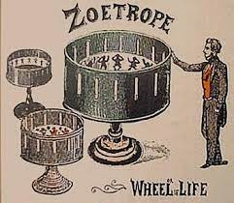
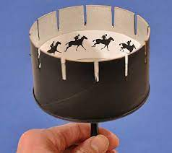
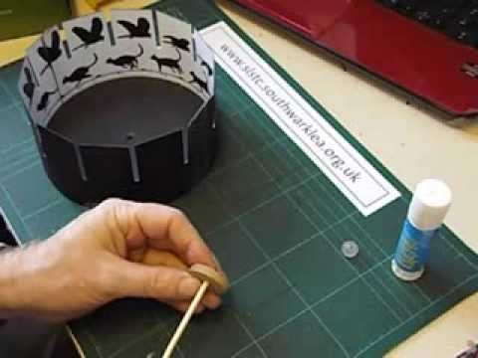
Topic A.1 The development of animation technology

Slide 13
Topic A.1 The development of animation technology
https://www.youtube.com/watch?v=40__creuq7c

Slide 14
Topic A.1 The development of animation technology
The zoopraxinoscope is an early animation device that was created to display motion pictures. It was created by Eadweard Muybridge in 1879, and it is considered to be the first movie projector.
The zoopraxinoscope projected images from rotating glass disks in rapid succession to give the impression of motion. The stop-motion images were initially painted onto the glass, as silhouettes.
A second series of discs, made in 1892–94, used outline drawings printed onto the discs photographically, then coloured by hand. Some of the animated images are very complex, featuring multiple combinations of sequences of animal and human movement.

Slide 15
Topic A.1 The development of animation technology
https://www.google.com/search?q=Zoopraxiscope&bih=576&biw=1200&hl=en-US&tbm=vid&ei=FOzWY4bDIa2PhbIP8JCUyAI&ved=0ahUKEwiGnbKe4-38AhWtR0EAHXAIBSkQ4dUDCA4&uact=5&oq=Zoopraxiscope&gs_lcp=Cg1nd3Mtd2l6LXZpZGVvEANQgwNYgwNg8QVoAHAAeACAAY8DiAGPA5IBAzMtMZgBAKABAcABAQ&sclient=gws-wiz-video#fpstate=ive&vld=cid:e47b2dfe,vid:aG5erS2GNG0

Slide 16
Topic A.1 The development of animation technology
Kinetoscope, forerunner of the motion-picture film projector, invented by Thomas A. Edison and William Dickson of the United States in 1891.
In it, a strip of film was passed rapidly between a lens and an electric light bulb while the viewer peered through a peephole. Behind the peephole was a spinning wheel with a narrow slit that acted as a shutter, permitting a momentary view of each of the 46 frames passing in front of the shutter every second.

Slide 17
Topic A.1 The development of animation technology
https://www.youtube.com/watch?v=sfI0NVC0hLU

Slide 18
Topic A.1 The development of animation technology
Cinématograph (Lumiere brothers)
A three-in-one device that could record, develop and project motion pictures, the Cinématograph would go down in history as the first viable film camera. Using it, the Lumière brothers shot footage of workers at their factory leaving at the end of the day.

Slide 19
Topic A.1 The development of animation technology
Cinématograph (Lumiere brothers)
The Cinématograph was a film camera that also functioned as a photo developer and projector: The lenses and magazines needed to be changed to in order to switch between the three functions. The film used was the same width as Edison's—35 mm—but the perforations were different: a round hole on each side of the image. The films were no more than 20 m long.

Slide 20
Topic A.1 The development of animation technology
https://www.youtube.com/watch?v=Y4tW5SekrxY

Slide 21
Topic A.1 The development of animation technology
Flip book
Flipbook animation has been around for over 150 years. Pierre-Hubert Desvignes is credited with creating a version of the flipbook around 1860, though John Barnes Linnett, a British lithograph printer, was the first to patent the design.

Slide 22
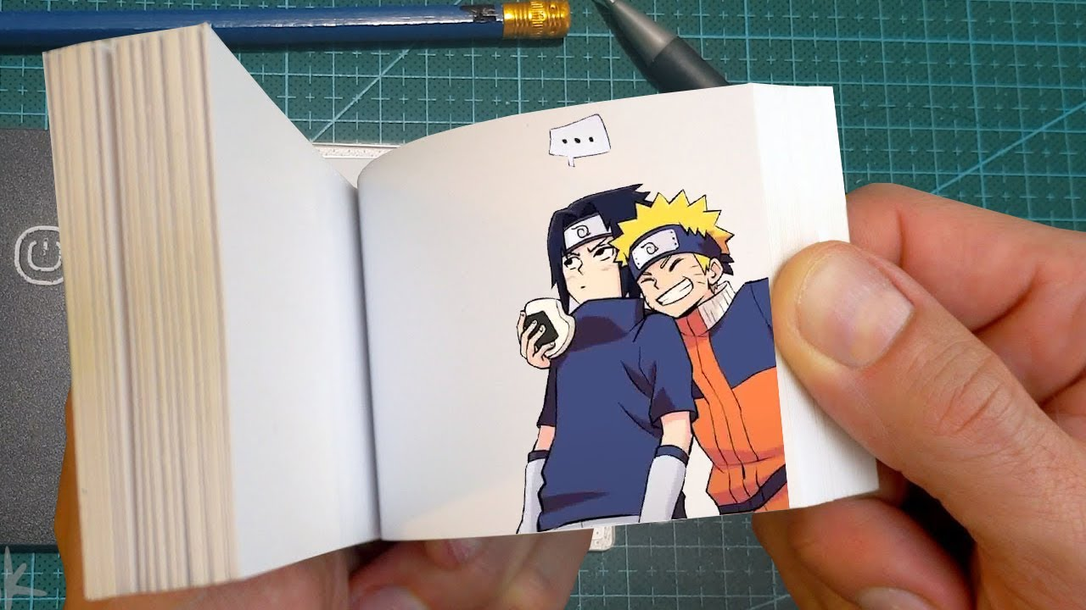
Topic A.1 The development of animation technology

Slide 23
Topic A.1 The development of animation technology
Task
https://www.youtube.com/watch?v=wgl_vjFxjzo
https://www.youtube.com/watch?v=ycKIANTmTP0

Slide 24
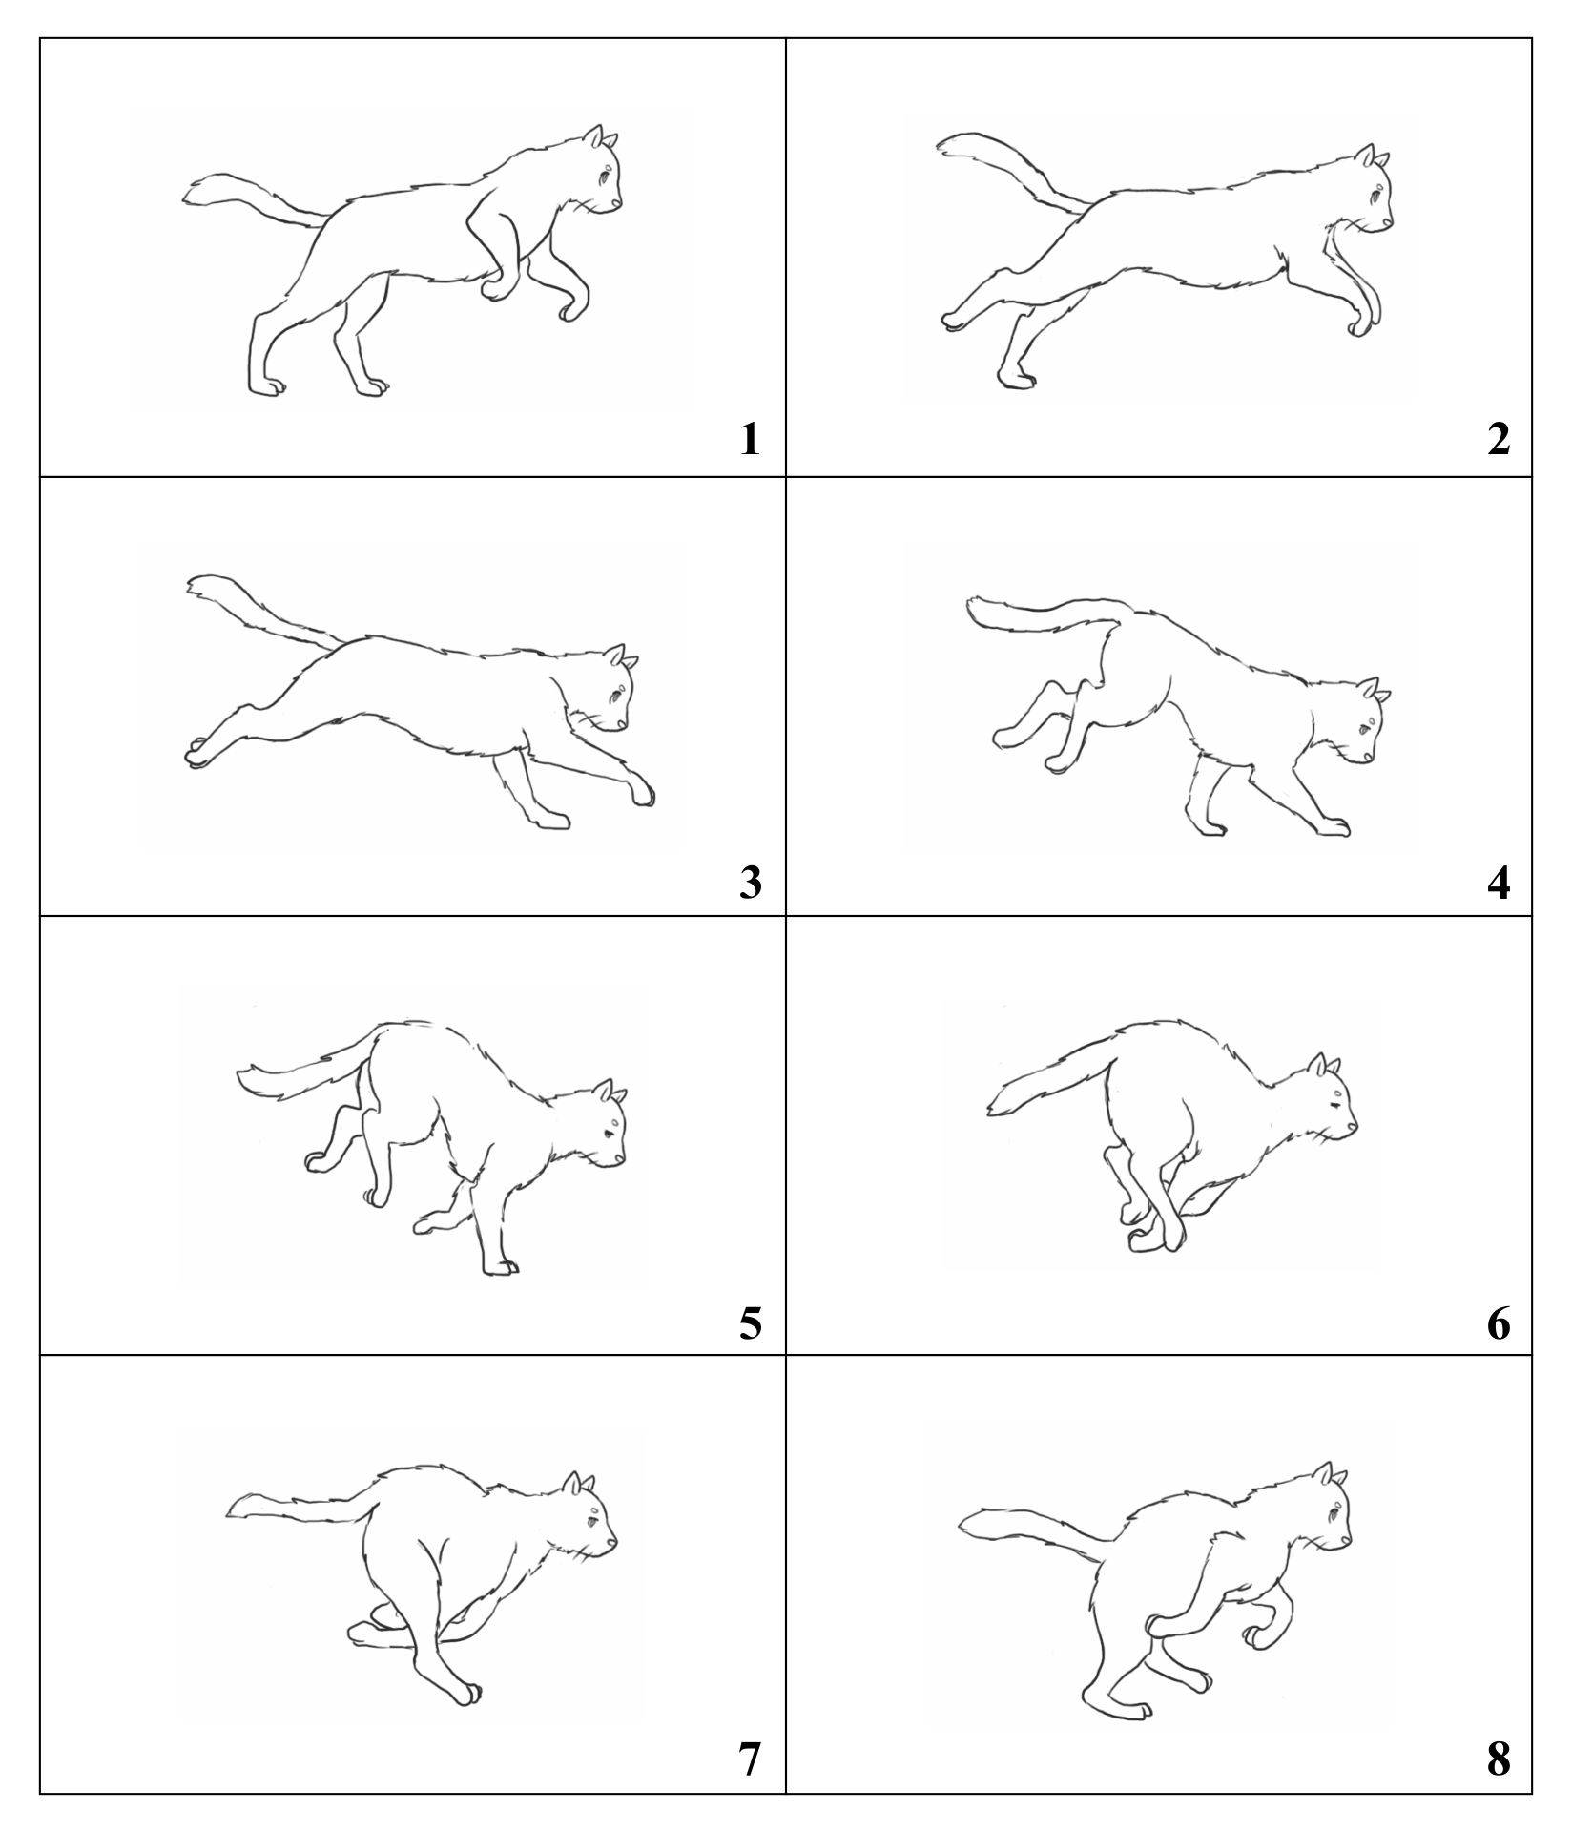
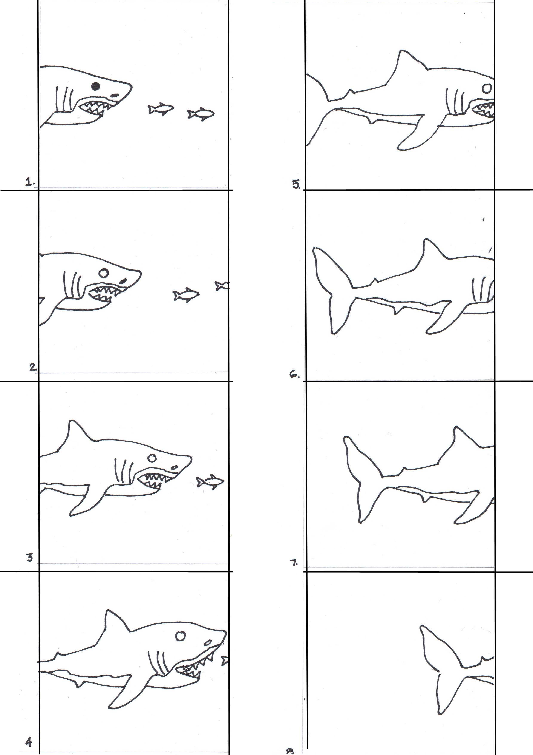
Topic A.1 The development of animation technology

Slide 25
Topic A.1 The development of animation technology
Steamboat Willie
Steamboat Willie is a black-and-white animated Disney short that was the first cartoon of any kind to use completely synchronized sound.

Slide 26
Topic A.1 The development of animation technology
Steamboat Willie
https://www.google.com/search?q=steamboat+willie+full+movie&biw=1200&bih=576&tbm=vid&ei=pvTWY97MKILPgQbm7qGABA&oq=steamboat+willie+full&gs_lcp=Cg1nd3Mtd2l6LXZpZGVvEAEYADIFCAAQgAQyBQgAEIAEMgYIABAWEB46CwgAEIAEELEDEIMBOgQIABBDOgoIABCxAxCDARBDOgUIABCGA1DyAliAC2C5G2gAcAB4AIABTYgBjQOSAQE2mAEAoAEBwAEB&sclient=gws-wiz-video#fpstate=ive&vld=cid:94110720,vid:BBgghnQF6E4

Slide 27
Topic A.1 The development of animation technology
Task
Research steamboat Willie and write about how it was created and how they added sound into the animation.

Slide 28
Topic A.1 The development of animation technology
CGI animation, e.g. Toy Story (Pixar/Disney, 1995)
CGI, or Computer-Generated Imagery, uses computer software to create still or animated visuals. It’s used to create 3D (and sometimes 2D) renderings as special effects in movies and TV shows.
The first full-length CGI movie was 1995’s Toy Story by Pixar. The pioneering technology and design of this film inspired an entire industry of feature films.

Slide 29
Topic A.1 The development of animation technology
https://www.youtube.com/watch?v=gmwFOKDBCYU

Slide 30
Topic A.1 The development of animation technology
Performance (motion) capture, e.g. The Polar Express (Warner Bros, 2004).
The Polar Express is one of the most popular holiday movies and is watched by millions of fans every holiday season.
When it first came out in 2004, viewers had mixed feelings about the technique that was used to create the movie.
Motion-capture had only been used for visual effects until then, so the technology was still new, and viewers thought it made the lifelike characters look kind of "creepy." But after a while, viewers warmed up to the idea and now love the holiday classic.

Slide 31
Topic A.1 The development of animation technology
Animation is the rapid display of a sequence of images to create an illusion of movement
• The most common method of presenting animation is as a motion picture.
• Each frame is a photograph, drawing, or computer-generated image
• Each frame differs slightly from the one before it
• Viewing the frames in rapid succession implies “motion”

Slide 32
Topic A.1 The development of animation technology
Physically manipulate real-world objects and photograph them one frame at a time to create the illusion of movement
• Create and tell non-physical non-real-world stories
Gumbasia was the first clay animation
• A short film produced in 1953 and released on September 2, 1955
• Produced by Art Clokey, who went on to create the classic series “Gumby” and “Davey and Goliath” using the same technique

Slide 33
Topic A.1 The development of animation technology
https://www.youtube.com/watch?v=3L1LI4pxTVI

Slide 34
Topic A.1 The development of animation technology
Cartoon animations
Produced in large numbers in the Golden Age of Hollywood; usually shown before feature films
• First animated full-length film: Snow White, 1937 (took 4 years to make)
• Moved to TV in the 1950’s, when TV became popular – Flintstones: first successful prime time TV cartoon

Slide 35
Topic A.2 How animation works
Animation is a series of images shown in quick succession, which we then perceive as moving. In this topic we are going to look at:
Illusion of movement
persistence of vision
beta movement
Frame rates (fps)
Suspension of disbelief, i.e., animation sometimes requires us to believe that which is impossible in the real world.

Slide 36
Topic A.2 How animation works
Illusion of movement
Op Art, also known as optical art, is a type of art that features optical illusions. The way that lines, shapes, space and colour are used can fool our eyes and brain to see movement that is not really there.
Op Art works are abstract. They are based on geometric designs such as parallel lines, spirals, waves, circles and checkerboard patterns. Often these are produced in black and white or highly contrasting colours. The designs make it difficult for our eyes to rest on one area. The viewer's eyes constantly move over the images, and this creates feelings that the work itself is moving

Slide 37
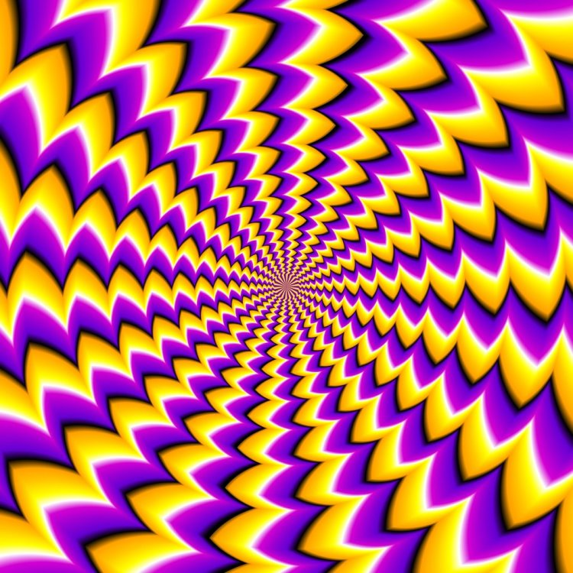
Topic A.2 How animation works
Illusion of movement

Slide 38
Topic A.2 How animation works
Illusion of movement- Task
https://www.youtube.com/watch?v=KnZQYXPJnXU
https://www.youtube.com/watch?v=3_3uQYTg9GQ

Slide 39
Topic A.2 How animation works
Frame rates
Frame rate greatly impacts the style and viewing experience of a video. Different frame rates yield different viewing experiences, and choosing a frame rate often means thinking about multiple factors, such as how realistic you want your video to look or whether or not you plan to use techniques like slow motion or motion-blur effects.

Slide 40
Topic A.2 How animation works
Frame rates
12 fps animation
24 fps film
25 fps television

Slide 41
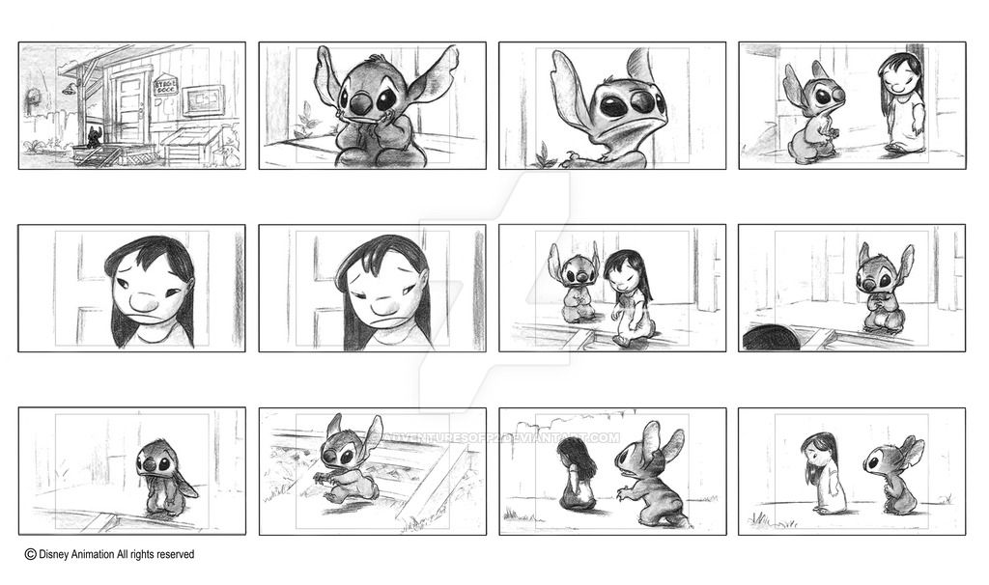
Topic A.2 How animation works
Task

Slide 42
Topic A.2 How animation works
https://www.youtube.com/watch?v=i3CEE9xKKZc

Slide 43
Topic A.2 How animation works
Task
You are going to choose a famous animation and find out all about it.
Who designed the characters
About the artists
How long it took to create
How it was created behind the scenes

Slide 44
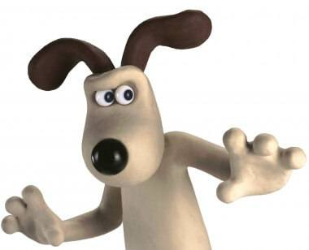
Topic A.2 How animation works
Suspension of disbelief, i.e., animation sometimes requires us to believe that which is impossible in the real world.
Wallace and Gromit – makes viewers believe that these characters are real, but these are made up characters that are made of plasticine.

Slide 45
Topic A.3 Animators
In this topic we are going to look at animators from different periods.
Historical (pre-digital era) -Jan Švankmajer, Walt Disney, Willis O’Brien, Ray Harryhausen, Len Lye

Slide 46
Topic A.3 Animators
Jan Švankmajer is a surrealist filmmaker known for his avant-garde use of three-dimensional stop-motion coupled use with live action animation and he has influenced people such as Tim Burton.
Jan Švankmajer films are not common films and are quite unusual, people did not like them, and authorities hindered and eventually banned him from making films.

Slide 47
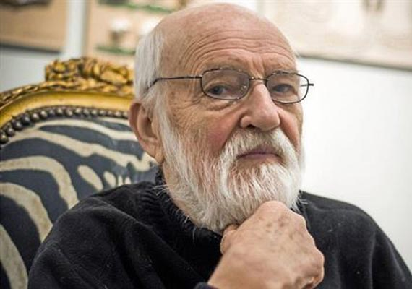
Topic A.3 Animators
Jan Švankmajer
https://www.youtube.com/watch?v=OwwGw01kEbM
https://www.youtube.com/watch?v=L-gGpWpra-g

Slide 48
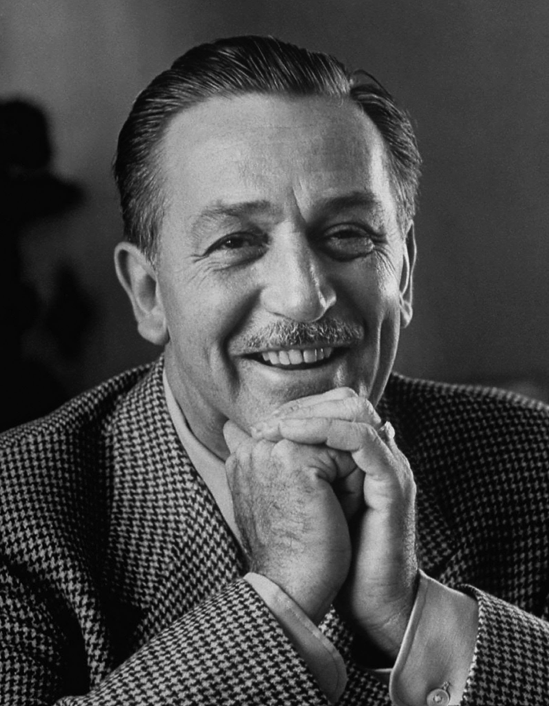
Topic A.3 Animators
Walt Disney- Walt Disney was an American motion picture and television producer and showman, and as the creator of the amusement parks Disneyland and Disney World.

Slide 49
Topic A.3 Animators
Walt Disney’s first full-length animated film was Snow White and the Seven Dwarfs. It came out 21st December 1937 and it made over 1.4 million dollars.
In 1919, Disney moved to Kansas City to pursue a career as a newspaper artist. Disney worked at the Kansas City Film Ad Company, where he made commercials based on cut-out animation.

Slide 50
Topic A.3 Animators
Around this time, Disney began experimenting with a camera, doing hand-drawn cel animation. He decided to open his own animation business.

Slide 51
Topic A.3 Animators
Hand-drawn Cel animation
Cel animation is one of the most traditional forms of animation and involves objects - usually characters - being hand-drawn on clear celluloid sheets and placed over painted backgrounds. These are known as animated cels or animation cels. Artists at Walt Disney Studios popularised the technique from the 1930s. Cel animation was standard practice throughout the 1950s and 60s through to the 80s with films like The Little Mermaid.

Slide 52
Topic A.3 Animators
Hand-drawn cel animation
https://www.youtube.com/watch?v=q_PsbmR1XZU

Slide 53
Topic A.3 Animators
Willis O’Brien was described as a “two fisted, hard drinking Irishman from Oakland”. Early in life, he worked as a cowboy, a marble cutter, a prize fighter, and a cartoonist. He then went on to create a short film called the dinosaur and the missing link. Willis O’Brien then went onto create King kong.
Though Willis O’Brien was not the director of King Kong, he was in charge of all of the film’s animation and visual effects, and with so much of the film relying on those elements, the bulk of the picture fell on O’Brien’s shoulders.19 With Kong, he had to pull out all the stops.
All of the techniques that O’Brien had developed up to that point in his career were employed, and many more were developed specifically for Kong. The stop-motion puppets O’Brien’s team created were the first to use metal, ball-and socket armatures, a mainstay of stop-motion ever since.

Slide 54
Topic A.3 Animators
Willis O’Brien- The dinosaur and the missing link
https://www.youtube.com/watch?v=BOD8ZS4drWU
Willis O’Brien- King Kong
https://www.youtube.com/watch?v=uGNQ5vRxNU8

Slide 55
Topic A.3 Animators
Ray Harryhausen was born June 29th, 1920, in Los Angeles and died May 7th, 2013, in London. He was an American filmmaker best known for his use of stop-motion animation effects. Ray grew up in Los Angeles and had a love of dinosaurs and fantasy at a young age.
His parents encouraged him to pursue his dream in making movies and films. After seeing the work that Willis O’Brien had created, he then decided to give it a go and with Willis O’Briens advice he enrolled at a art college in Los Angeles.
After that he began developing the technique that became known as “Dynamation,” used to make it appear that actors on film are interacting with animated models. In 1940 Harryhausen landed his first animating job, working for producer George Pal on a number of “Puppetoons”—short films that animated puppets by using a type of stop-motion.

Slide 56
Topic A.3 Animators
Ray Harryhausen
https://www.youtube.com/watch?v=exs-ivqak4k

Slide 57
Topic A.3 Animators
Len Lye
In the late 1920s and 1930s, New Zealand artist Len Lye (1901–1980) was at the forefront of experimental film-making in London. He carved sculptures from stone but also used cardboard or tin. As well as making paintings with oils, he used the batik technique of wax-resist dyeing. He wrote poetry and designed books.
Lye was best known for the abstract animated sequences that sometimes appeared in his films. Rather than use a camera, he would paint and scratch directly onto the film. Lye felt that the resulting animations conveyed a ‘body energy’, underlined by their jazz soundtracks.
These experimental films were produced as adverts for Post Office products, cigarettes, Imperial Airways, Shell Oil and the Ministry of Information. Shown in cinemas across the country, Lye’s films were seen by larger audiences than any other experimental art of the period. Under the guise of advertising, they introduced the general public to artistic movements such as abstraction and surrealism.

Slide 58
Topic A.3 Animators
Len Lye
https://www.youtube.com/watch?v=ojsRWoYpVfU
https://www.youtube.com/watch?v=mj9PDKYaQfM

Slide 59
Topic A.3 Animators
In this topic we are going to look at animators from different periods.
Contemporary (post-digital era), e.g. John Lasseter, the Quay Brothers, Tim Burton, Nick Park.

Slide 60
Topic A.3 Animators
John Lasseter
John Lasseter’s full name is John Alan Lasseter, he was born January 12th 1957 in Hollywood California. He is best known for his work on films such as Toy Story 1995 the first fully computer-animated feature and its sequels 1999, 2010.
John’s mother was an art teacher and she was the one who inspired John. He attended California institute of the arts and then began working for Disney and the first film he work on was the fox and the hound.

Slide 61
Topic A.3 Animators
John Lasseter
https://www.google.com/search?q=john+lasseter+animation+youtube&ei=peIEZP_oHImA8gK4grGwCg&oq=john+lasseter+animation+you&gs_lcp=Cgxnd3Mtd2l6LXNlcnAQAxgAMgUIIRCgATIFCCEQoAEyCAghEBYQHhAdOgoIABBHENYEELADOgUIABCABDoGCAAQFhAeOgUIABCGA0oECEEYAFBiWNMHYIkQaAFwAXgAgAF1iAG9ApIBAzMuMZgBAKABAcgBCMABAQ&sclient=gws-wiz-serp#fpstate=ive&vld=cid:0b5a90b7,vid:0Hfenc5IRkc

Slide 62
Topic A.3 Animators
The Quay Brothers
The Quay Brother are identical twins born in Pennsylvania in 1947, the brother studied in London at the Royal College of Art before going into a cinematic career making short films in the late 1970’s.
The brothers defined an uncanny form of mixed live-action and animation film, amalgamating psychology, surrealism and a very particular flavour of Mittel European design.

Slide 63
Topic A.3 Animators
The Quay Brothers
https://www.youtube.com/watch?v=nW3dW4yMLfE

Slide 64
Topic A.3 Animators
Tim Burton
Tim Burton’s full name is Timothy William Burton he was born 25th August 1958 in Burbank California. He is a famous director known for his quirky style of films.
Tim became interested in drawing and filmmaking whilst he was quite young, he attended the California Institute of the Arts and later worked as an animator at Disney Productions. After he made a series of short films, Tim directed his first feature film Pee-Wee’s Big Adventure in 1985.

Slide 65
Topic A.3 Animators
Tim Burton
https://www.youtube.com/watch?v=AhBxbUEIq1g

Slide 66
Topic A.3 Animators
Nick Park
Nick Park’s full name is Nicholas Wulstan Park, he was born 6th December 1958 in Preston Lancashire England. He is a British animator and director known for stop-motions films that often feature his characters Wallace and Gromit.
Park was able to draw at an early age and by the age of 13 he was animating his cartoon creation Walter the Rat with his mother’s standard 8mm movie camera. When he was 15 one of his homemade films was shown on television as part of BBC young animators film competition.

Slide 67
Topic A.3 Animators
Nick Park
https://www.youtube.com/watch?v=zQf0jUhqJYw
https://www.youtube.com/watch?v=OKcr9zF4j9M

Slide 68
Assignment 1
You are on a work placement at an animation production and have been asked to write a blog for visiting schools and colleges that informs them about the background history, uses and techniques of animation.

Slide 69
Assignment 1
Your blog needs to have:
What animation is
How it works
Phenakistoscope (Joseph Plateau, 1832)
Zoetrope (William Horner, 1834)
Praxinoscope (Emile Raynaud, 1877)
Zoopraxinoscope (Eadweard Muybridge, 1878)
Kinetoscope (Thomas Edison, 1894)
Cinematograph (Lumière brothers, 1895)
sound in animation, e.g. Steamboat Willie (Disney, 1928)
standardisation of film, e.g. 24 fps
CGI animation, e.g. Toy Story (Pixar/Disney, 1995)
performance (motion) capture, e.g. The Polar Express (Warner Bros, 2004).
Historical (pre-digital era), e.g. Jan Švankmajer, Walt Disney, Willis O’Brien, Ray Harryhausen, Len Lye
contemporary (post-digital era), e.g. John Lasseter, the Quay Brothers, Tim Burton,Nick Park.

