Slide 1
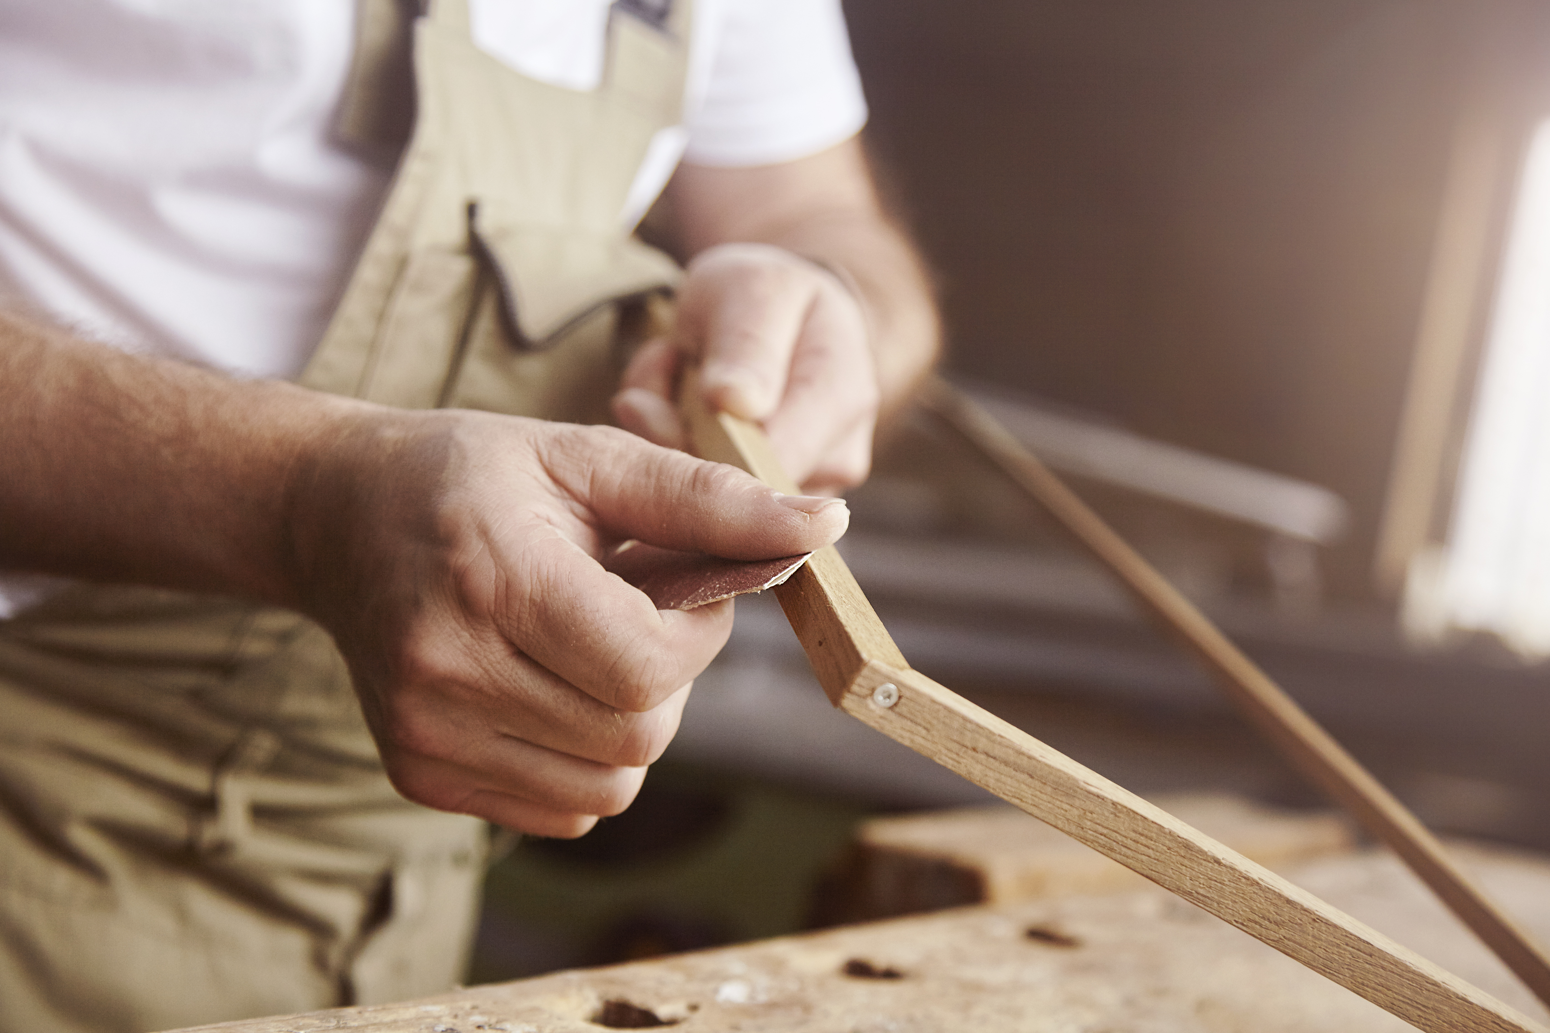
Unit 6: Exploring Carpentry and Joinery Principles and Techniques

Slide 2
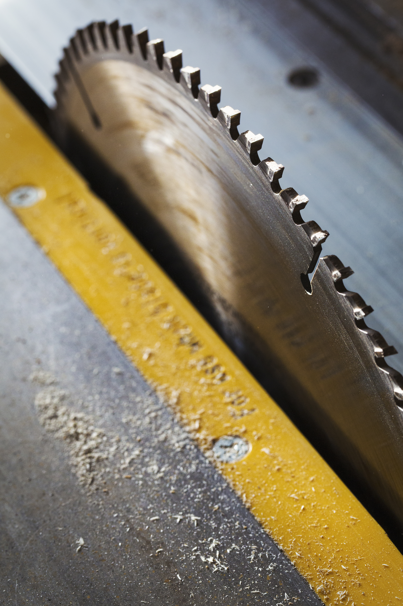
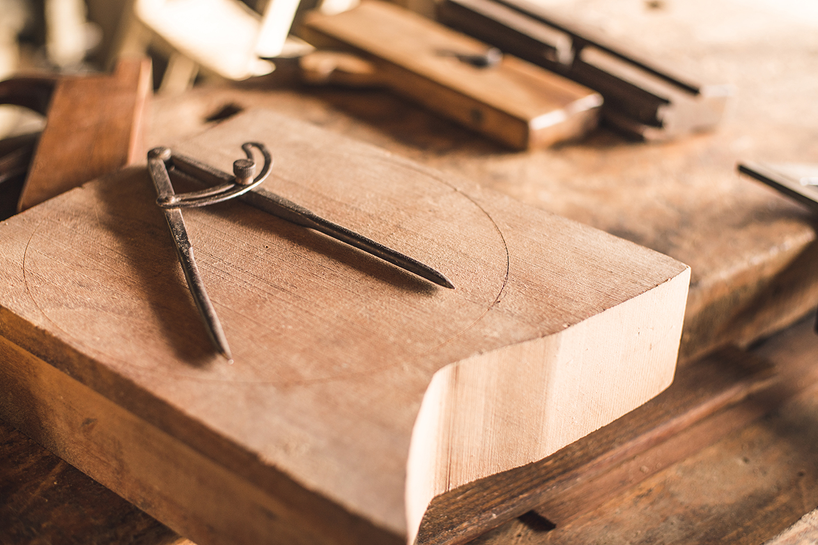
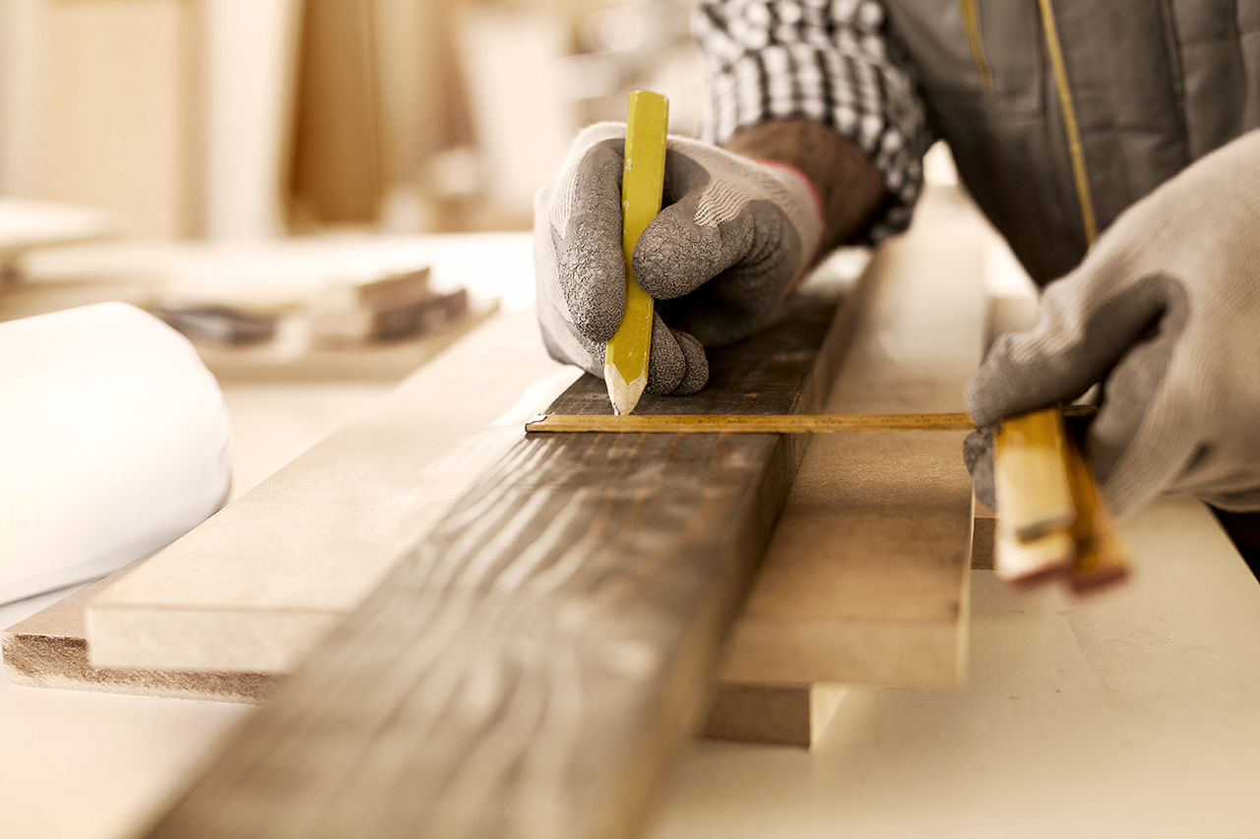
Introduction to unit
Understand tools, materials and equipment used in carpentry and joinery.
Understand and demonstrate joints.

Slide 3
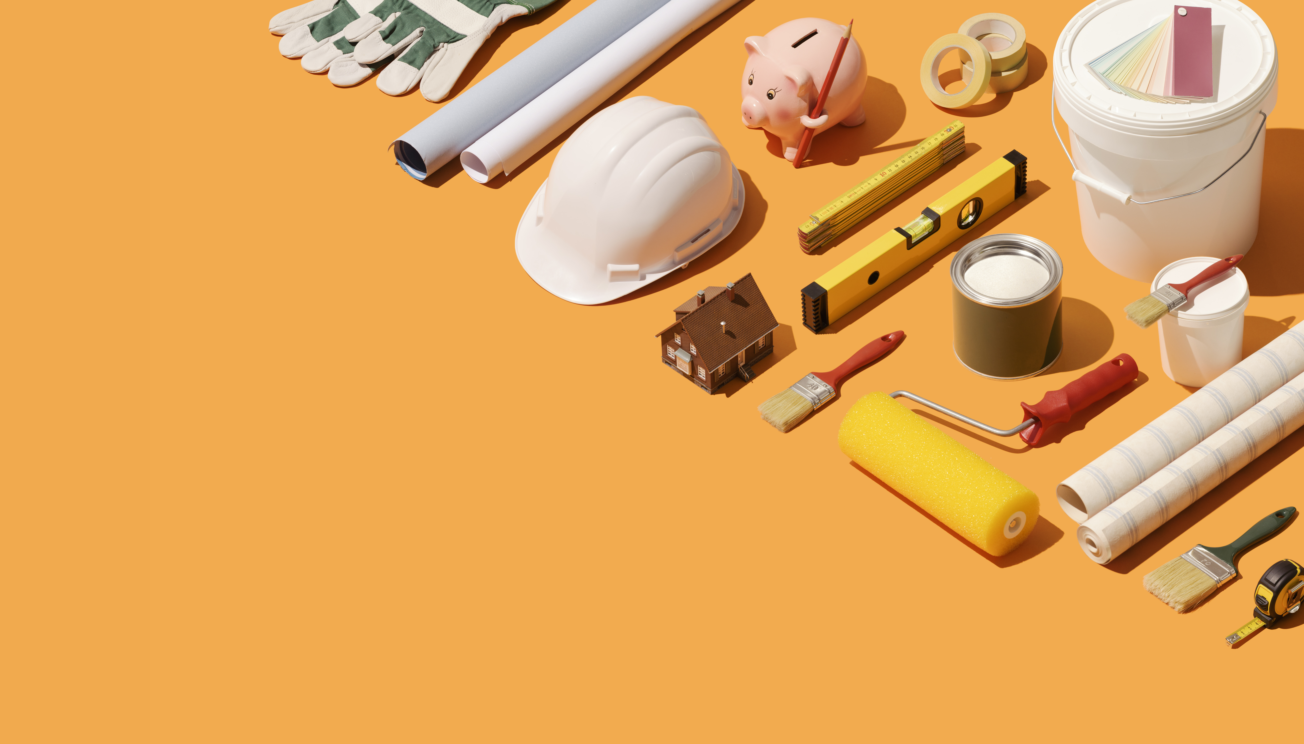
TOOLS & EQUIPMENT

Slide 4
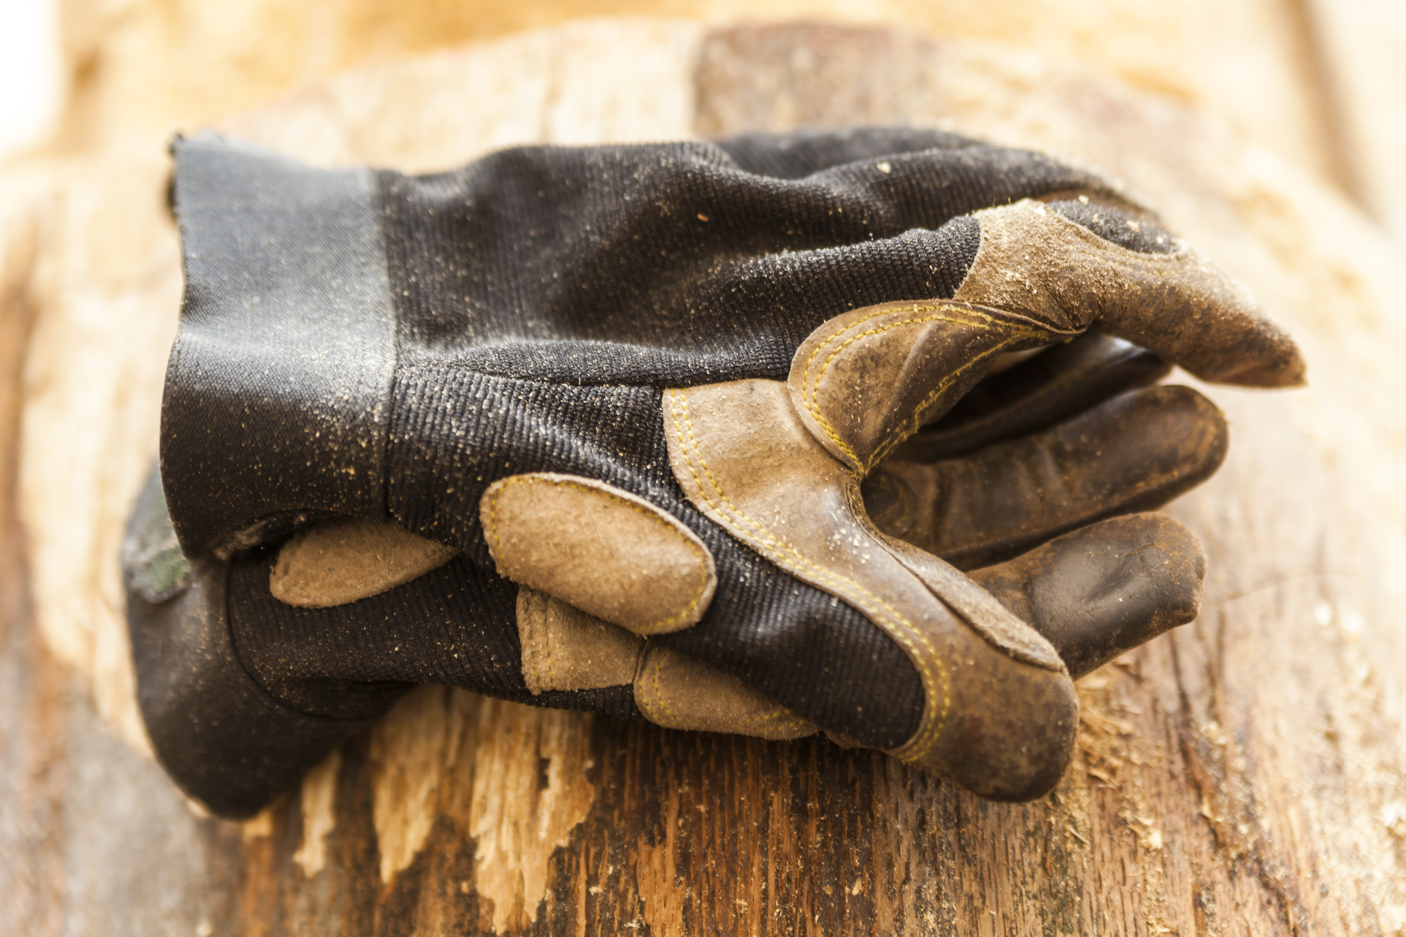
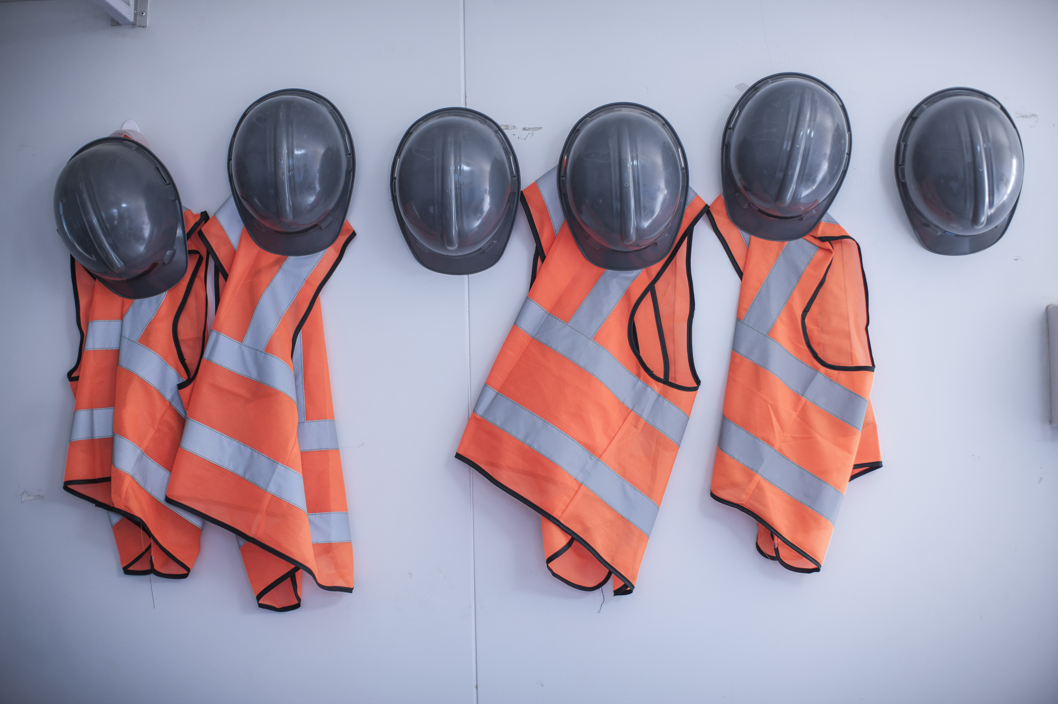
HEALTH & SAFETY PPE

Slide 5
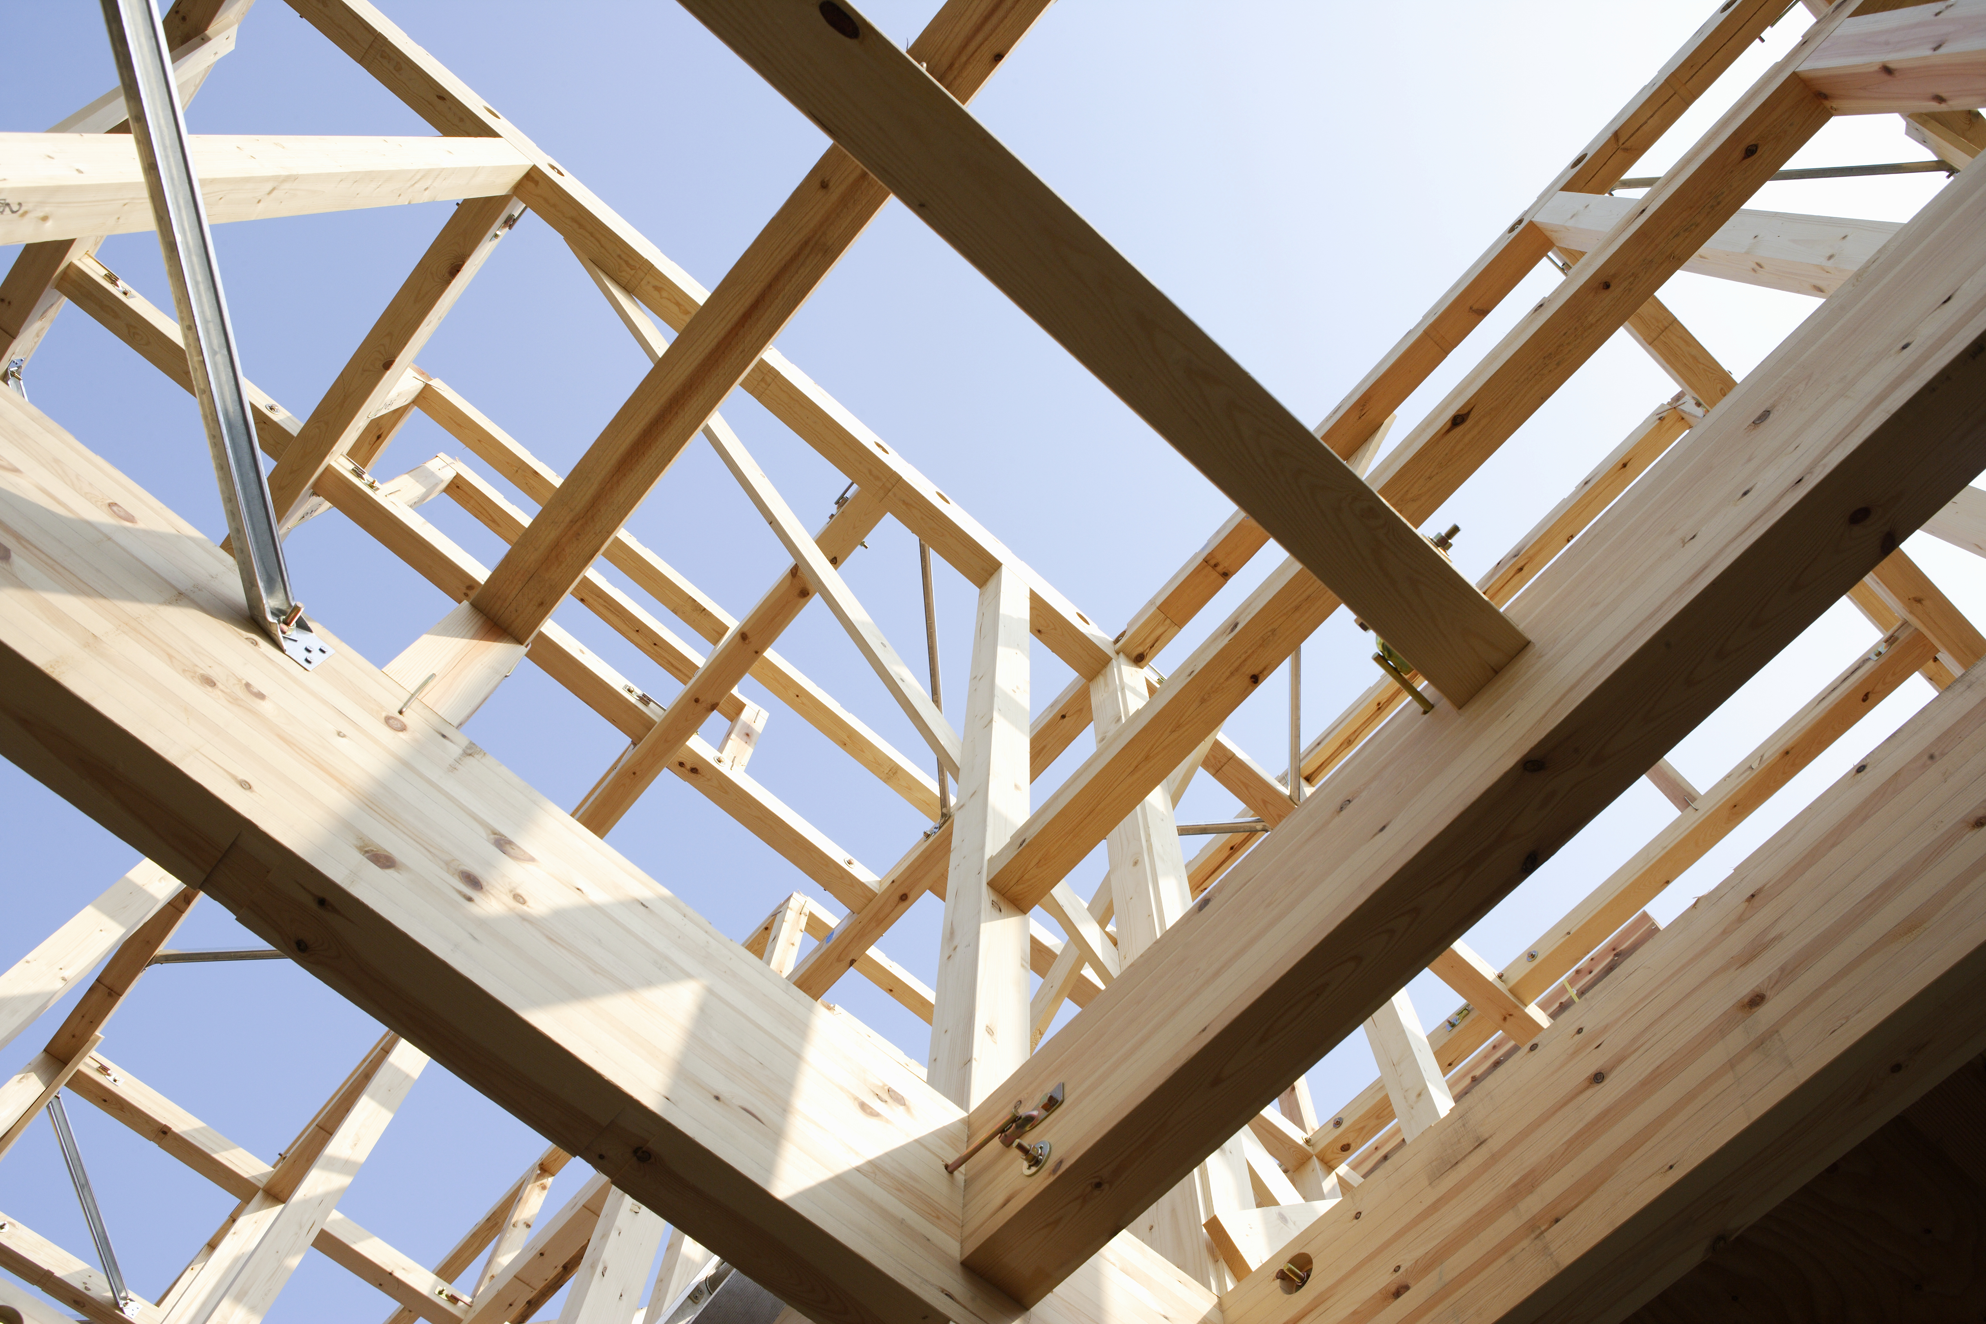
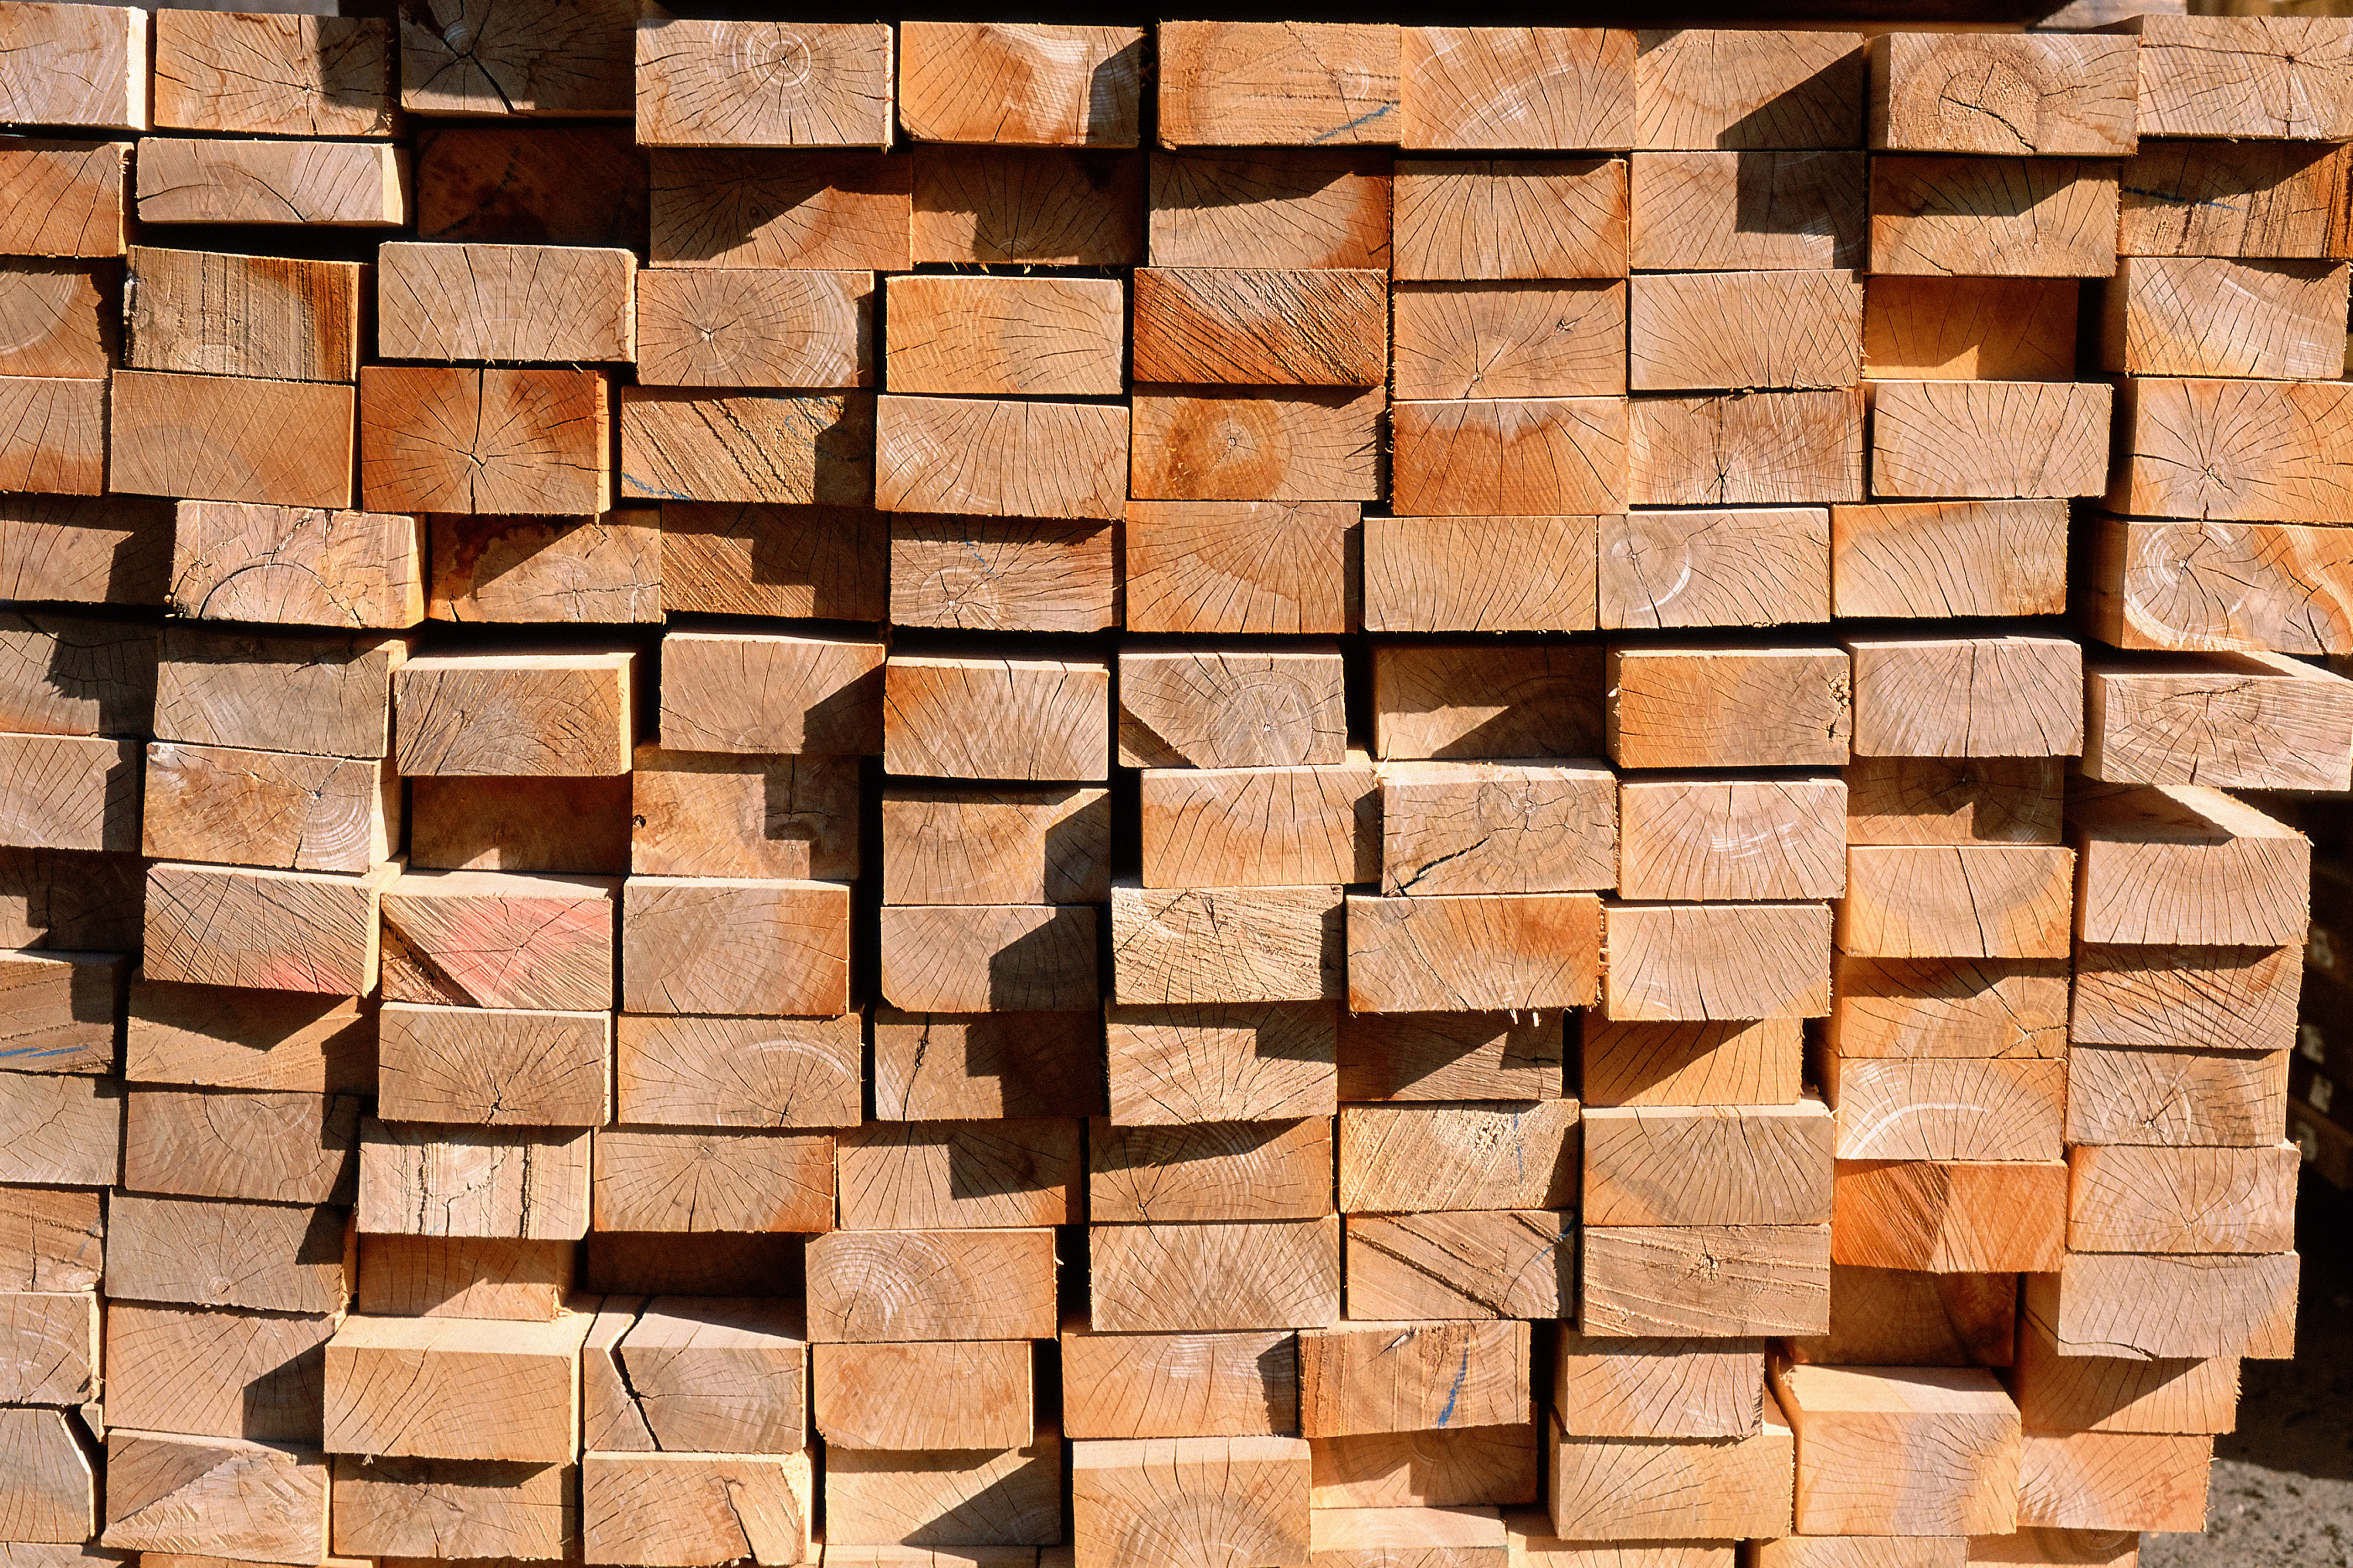
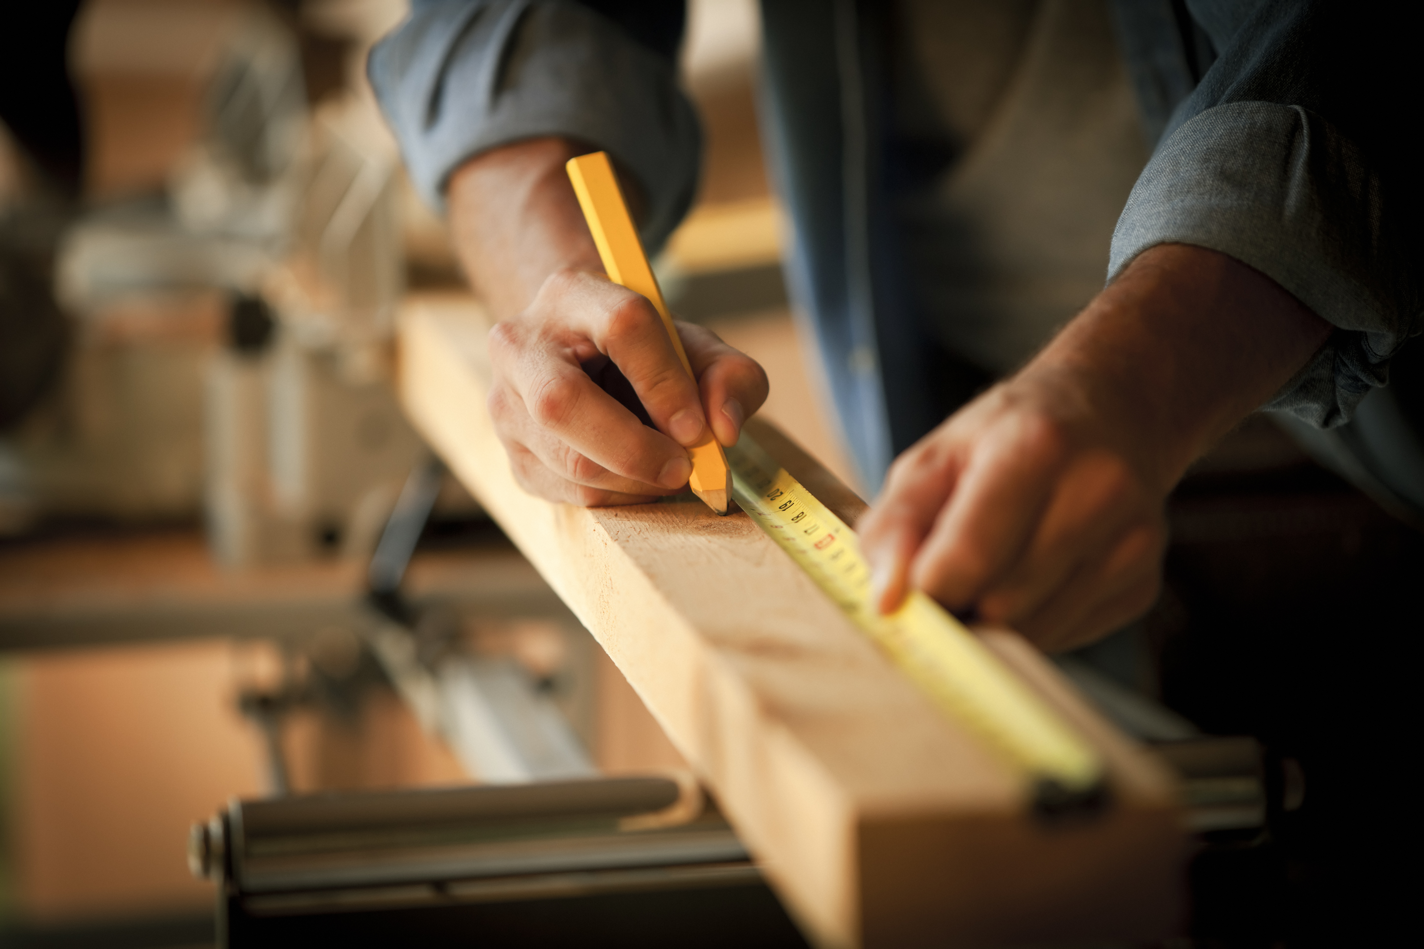
TYPES OF WOOD

Slide 6
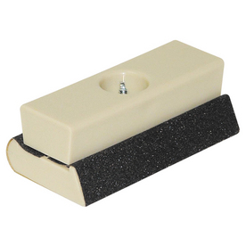
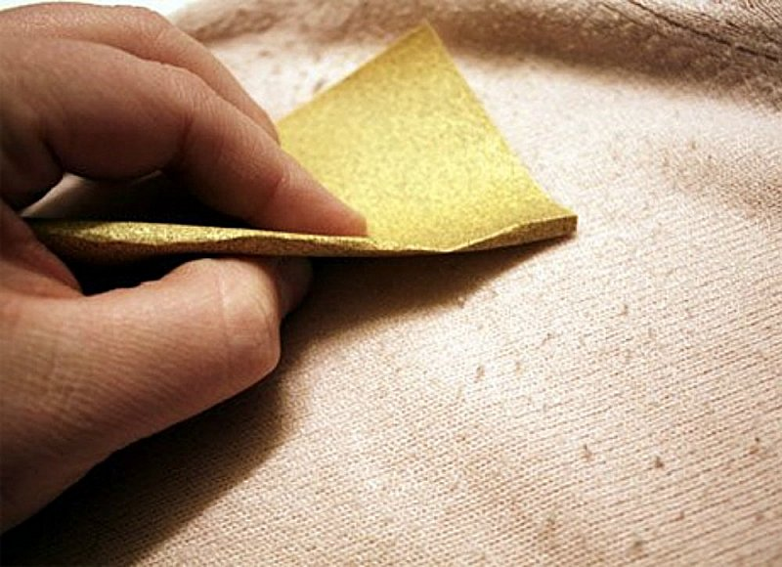
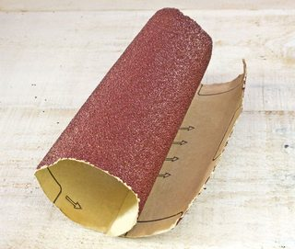
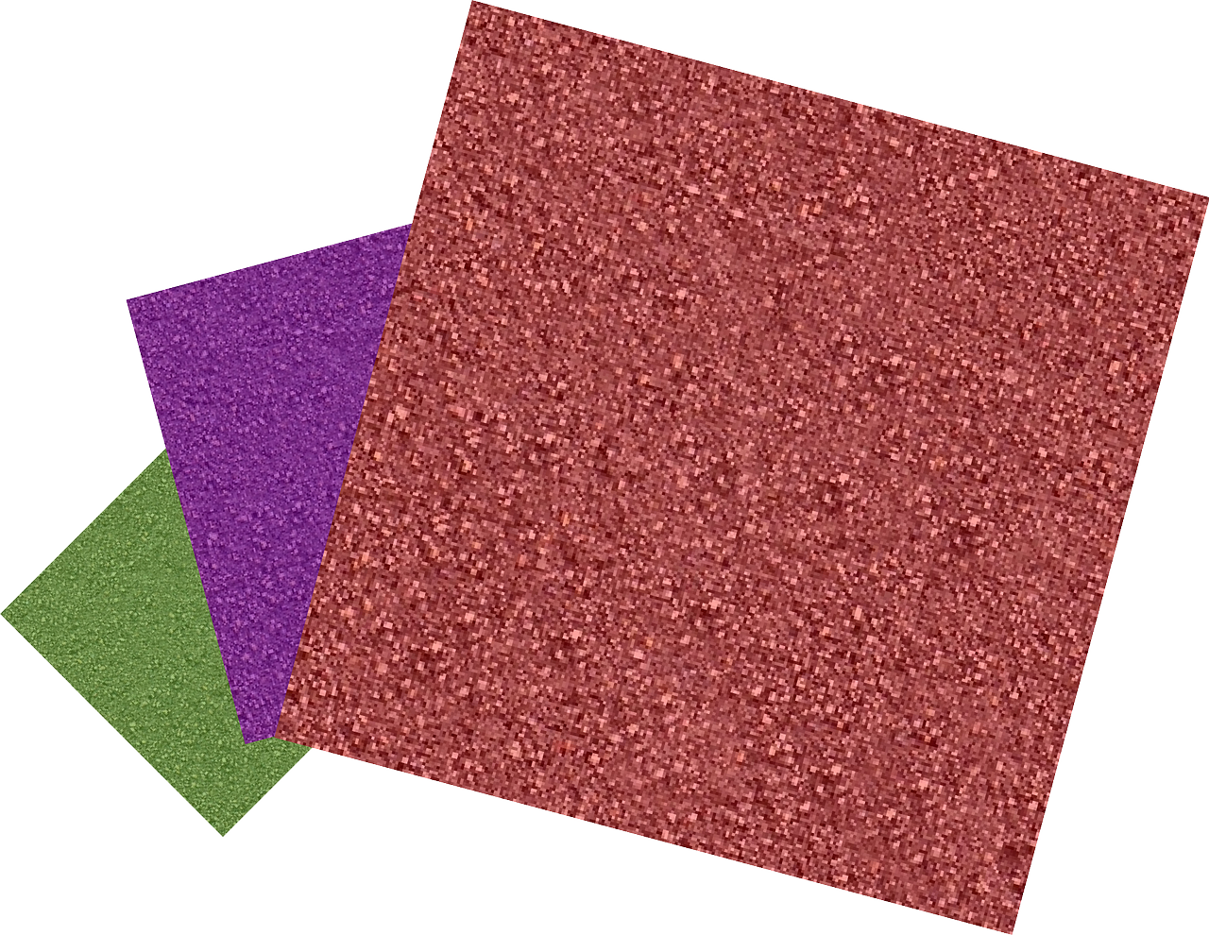
SAND PAPER
This Photo by Unknown author is licensed under CC BY-SA.
This Photo by Unknown author is licensed under CC BY-ND.
This Photo by Unknown author is licensed under CC BY-SA.

Slide 7
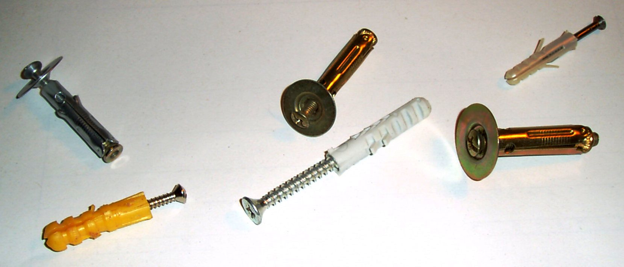
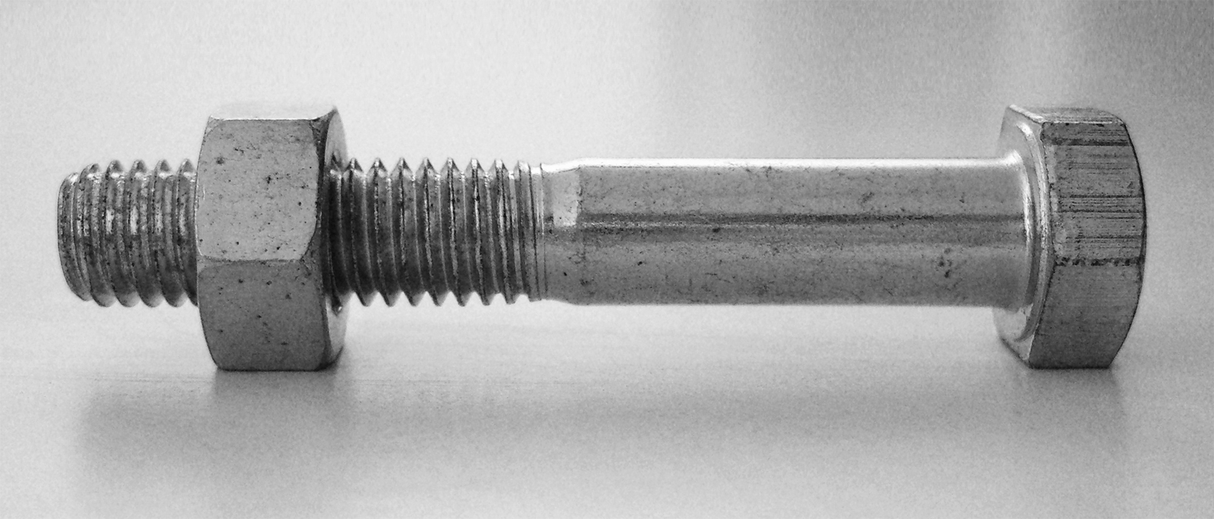
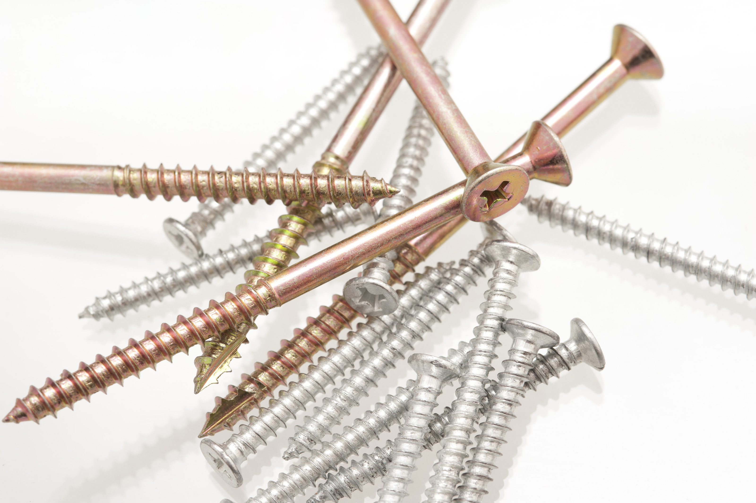
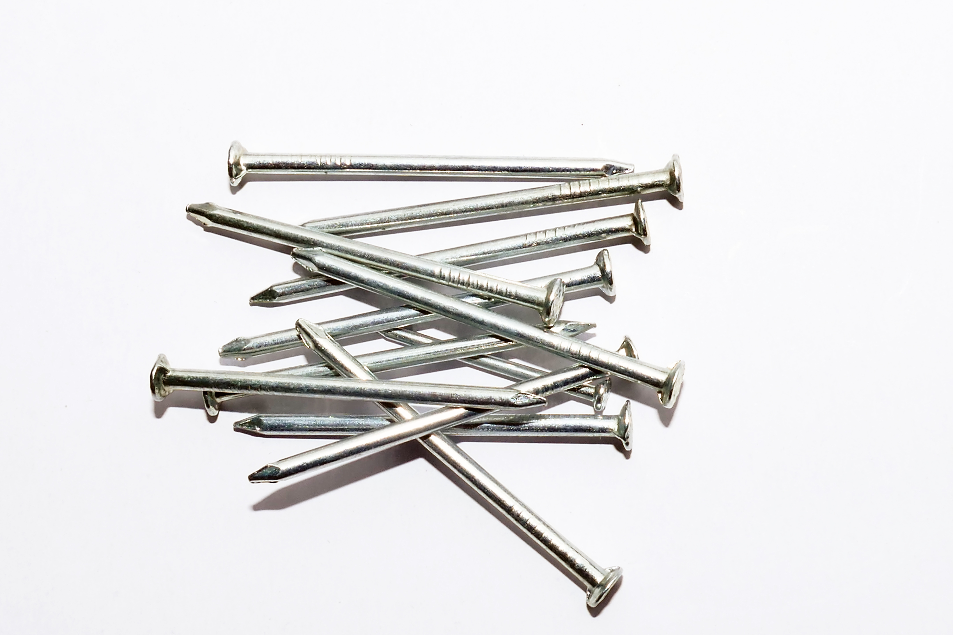
FIXINGS
This Photo by Unknown author is licensed under CC BY-SA.
This Photo by Unknown author is licensed under CC BY.

Slide 8
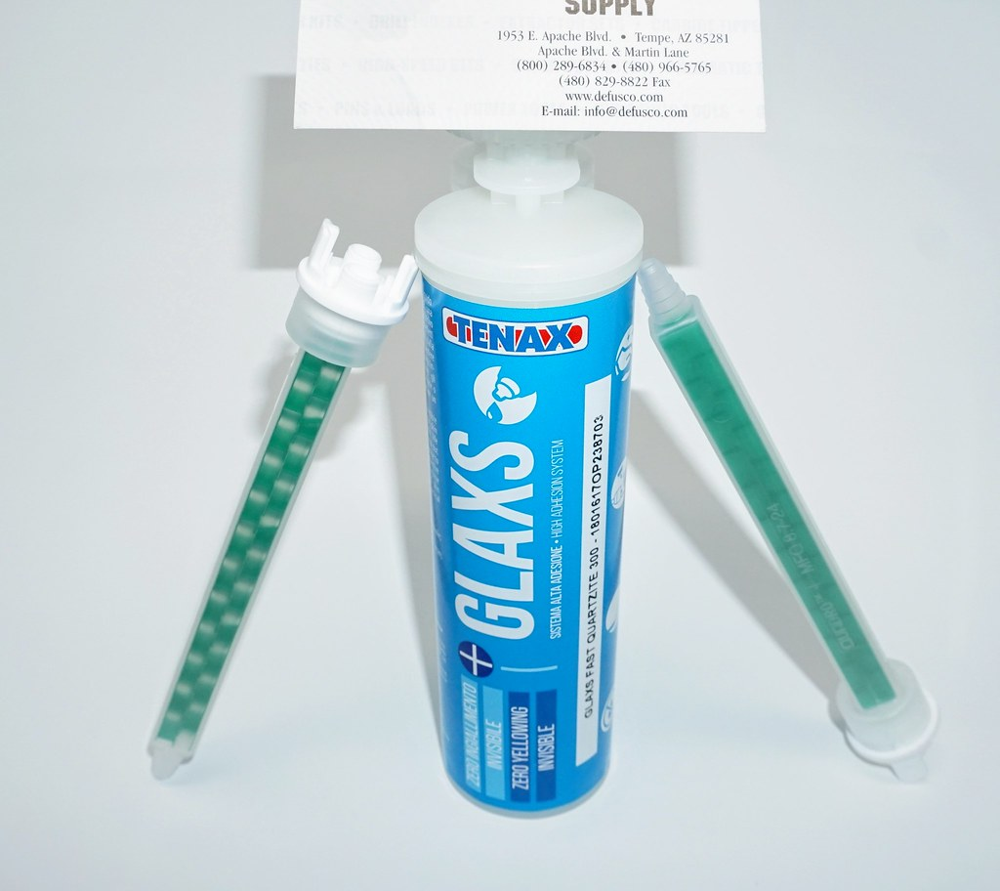
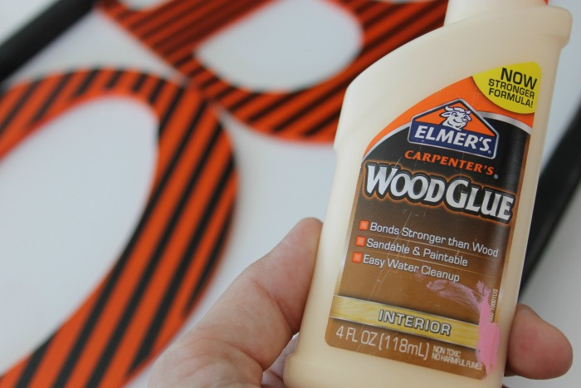
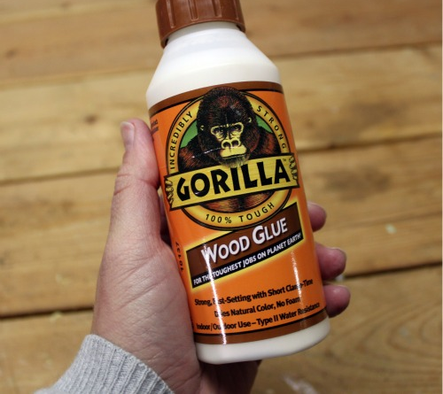
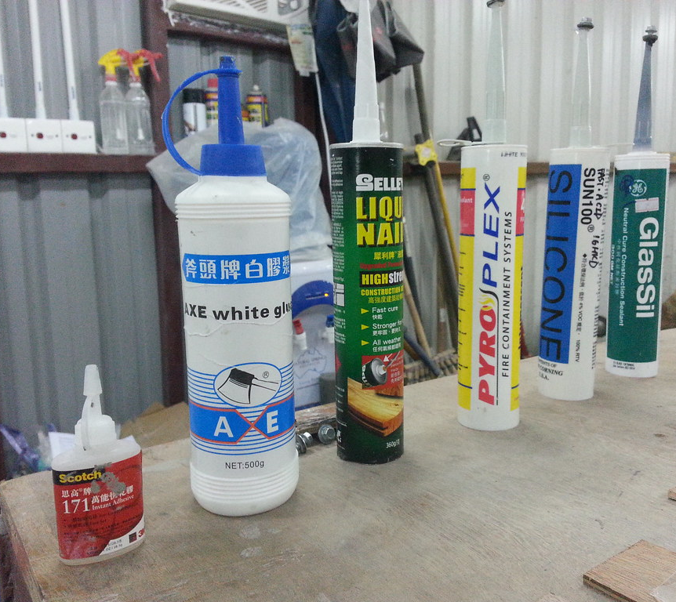
WOOD GLUES
This Photo by Unknown author is licensed under CC BY-NC-ND.
This Photo by Unknown author is licensed under CC BY-SA-NC.
This Photo by Unknown author is licensed under CC BY-SA-NC.

Slide 9
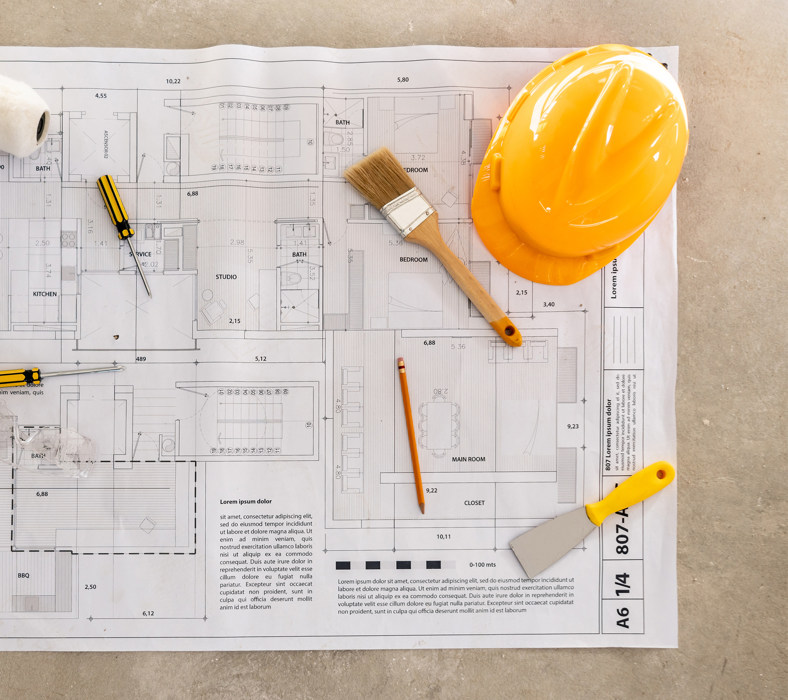
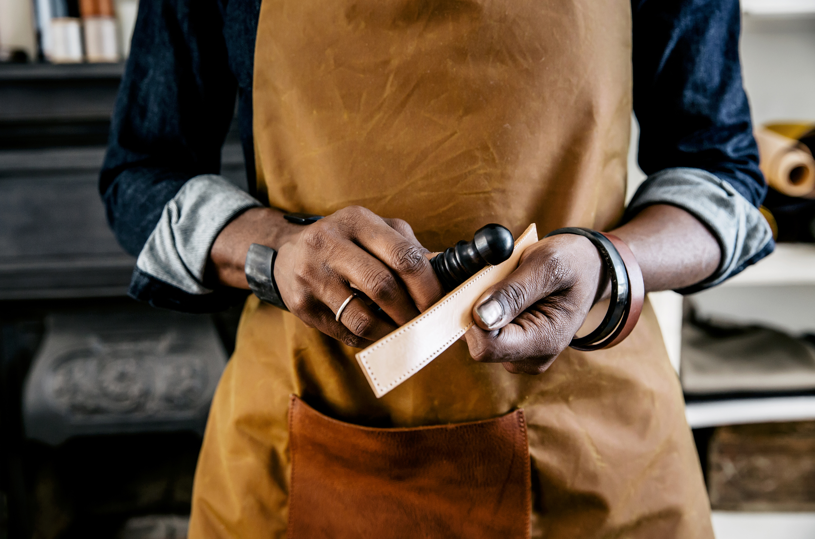
Learning aims
Preparing to work effectively with carpentry and joinery tools and equipment
Develop practical skills using safe techniques to produce a timber frame.
Understanding of Health & Safety
Risk assessments

Slide 10
Assessment criteria
Identify the purpose of tools and equipment, and the use of materials in carpentry and joinery.
Outline the safe use and storage of carpentry and joinery tools, materials and equipment.
Explain the selection and use of appropriate tools, materials and equipment for carpentry and joinery.
Carry out a risk assessment prior to commencing the construction of a timber frame.
Comply with safe working practices including using appropriate personal protection equipment.

Slide 11
Assessment criteria
Measure and mark out four different types of joints for a 300 x 300 mm timber frame to a given specification dimensionally square to 3 mm.
Measure and mark out four different types of joints for a 300 x 300 mm timber frame to a given specification dimensionally square

Slide 12
TASK 1
Produce a PowerPoint presentation and written trainer notes for the induction training course.
you should cover a minimum of twelve appropriate tools, five types of fixings, two types of glue, three types of wood/wood composites, and three different types of equipment that can be used.

Slide 13
Producing a Timber Frame
Completed risk assessment
The size of the frame is 300 mm x 300 mm.
The frame will have any of the four joints as advised by your tutor (bridle joint, mitre joint, half lap joint, housing joint, tee halving joint, dovetail joint, mortice and tenon joint).
While measuring and marking out joints, make these dimensionally square to 1 mm.
Aim for a gap tolerance of ±1 mm for the frame.
Aim for a frame with no twists.

Slide 14
TIMBER FRAME

Slide 15
RECAP
TOOLS ?
PPE?
TYPES OF JOINTS?

Slide 16
QUESTIONS

